Slide 1


Slate
Multi-input wireless keypad
Group 8
Diego Agudelo, CpE Andhres Bolano-Melendez, CpE
Samuel Chodur, EE Jacob Goodman, CpE

Slide 2




The “Slate” Team
Diego Agudelo
Circuitry / PCB design & assembly
Samuel J. Chodur, Jr.
Testing, logistics, parts acquisition
Andhres Bolano-Melendez
Embedded and GUI programming
Jacob Goodman
Team lead, embedded and GUI programming

Slide 3
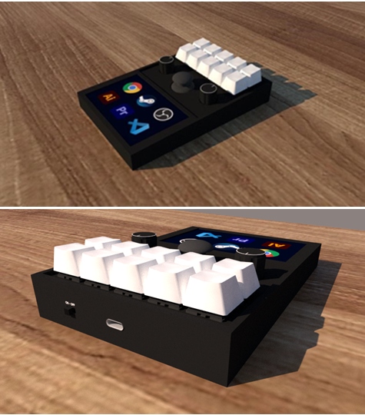
Motivation
Speed-up repetitive tasks in professional applications
Provide content creators with more control
Allow live streamers to accomplish multiple tasks quickly and easily
Customizable and portable
Notes:
Multi-tasking during live streaming is becoming more and more prevalent. A single user may be expected to accomplish the same amount of work that was accomplished by a multiple member team. As an example, production of a live television broadcast could be made up of the on-screen personality, a camera operator, and an audio engineer. With the increase in popularity of live streaming of events, being able to accomplish all these job descriptions as a single person is sometimes necessary or desired. This example is the main motivation for slate, but the functions available to the users of slate can be applied to more than just live streaming.

Slide 4
Goals and Objectives
Fully functioning customizable multi-input wireless macro keypad
Includes a user interface via touch screen, physical keys and rotary encoders.
The entire system should be portable.
Provides user-programmable macros.
Uses standard, user-serviceable switches for physical keys.
Interfaces wirelessly with accompanying device.
USB or Battery can power the device.
USB connection can charge device and provide data transmission to PC.
Programmable via mobile application with Bluetooth connection.
Programmable RGB LEDs for physical keys to denote function.
Haptic feedback for touchscreen input.
Onboard speaker to provide audio feedback.
User can select from multiple macro functions at any given time.
User can program the macro keypad using complementary software.
Notes:
The goal of Slate is to have a fully functioning customizable multi-input wireless macro keypad that combines a touch-display with multiple physical inputs to provide macro functionality to the user in a compact and robust form-factor.
After brainstorming and investigating products like Slate, the main features and functions were identified. The results of which were:
user interface via touch screen, physical keys and rotary encoders.
Portable.
user-programmable macros.
Uses standard, user-serviceable switches for physical keys.
Interfaces wirelessly with accompanying devices.
USB or Battery powered
USB connection can charge device and provide data transmission to a PC.
Programmable via mobile application with Bluetooth connection.
User can select from multiple macro functions at any given time.
User can program the macro keypad using complementary software.

Slide 5
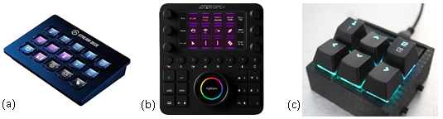
Market Analysis
 | Elgato Stream Deck (a) | Loupedeck Live (b) | DIY Solution (c)
Length (inches) | 4.6 | 5.9 | 4.0
Width (inches) | 3.3 | 4.3 | 3.0
Height (inches) | 0.8 | 1.2 | 1.0
Weight (oz) | 6.7 | 8.1 | 5.0
Price (USD) | $150 | $150 | $100
Target Customer | Live Streamers | Live Streamers | Power Users
Supported OS | Windows, macOS | Windows, macOS | Windows, macOS, Linux
Notes:
There are several products in the market that attempt to offer similar solutions as Slate. We feel that Slate can offer a better level of choice, flexibility, and affordability compared to these competitors.
The key features for each of the three other products available in the market are summarized in the displayed table.
The investigation of these products provided Slate’s team with what should be the minimal expectations for our product design. We were also able to identify key features and engineering standards with the help of our market analysis.

Slide 6
Engineering Requirements
Engineering Requirement | Justification
Slate’s touch screen input shall have an input response time less than 100ms. | Input response time of the touch screen is an important factor for users of macro-keyboard devices.
Slate’s physical keys shall have an input response time less than 100ms. | Input response time of physical keys is expected to be imperceivable for most products on the market today.
Slate’s touch screen will have input accuracy greater than 90%. | Users of similar devices expect their inputs to be read accurately.
Slate shall operate wirelessly for at least 10 hours at idle (ready) state starting with a fully charged battery. | Based upon current products in the market.
Slate shall provide at least six programmable macro functions. | This allows for a suitable number of functions while not requiring an exuberant amount of memory.
Slate shall maintain all performance and functionality requirements when connected via Bluetooth. | Users will expect all functionality to remain the same no matter the host connection type.
Slate shall maintain performance and functionality requirements no matter the power source. | Users will expect all functionality to remain the same no matter the power source.
Slate’s battery shall charge from 0% to 50% in less than 4 hours when connected to a USB power source. | A rechargeable battery is something that is expected in nay portable device in today’s market.
Slate shall provide up to three profiles for selection by the user. | Multiple profiles allow for use cases related to different software.
The total cost of developing the system should not exceed $1,000. | The group has a limited budget.
The total for manufacturing cost and parts should not exceed $150. | To be considered competitive in the market space, the price of the final product must be affordable.
Notes:
The engineering requirements for Slate are shown in the displayed table and they are centered around performance, functionality, energy and economics. The performance requirements are shown in requirement numbers 1, 2, 3 and 4 which mainly have to do with perceived latency and accuracy of input devices. Functionality is addressed with requirements 5, 6, 7 and 9. It is important for Slate to not have any loss of functionality when connected wirelessly. An energy requirement of the project is identified in requirement 8. Lastly, Economic requirements are highlighted in requirements 10 and 11.

Slide 7
Project Constraints
Engineering Constraint | Justification
The size of the prototype should not exceed 6" x 6" x 2". | Slate should be easily transportable and blend in with most user setups.
The weight should not exceed 12oz / 340g. | Slate should be easily transportable.
The product should maintain operational between temperatures of 0° to 70°C | Slate should meet common commercial use standards for temperature.
Slate shall meet all safety requirements specified in the ANSI C18.2M Part 2 standard. | Slate must not constitute a safety hazard regarding its power and charging system.
All components of slate will meet or exceed standards defined in IEC standard 62680. | Following USB standards ensures compatibility with USB systems and components.
Wireless communications conducted between Slate and host systems will follow the standards described in IEEE 802.15.1for Bluetooth. | Following Bluetooth standards ensures compatibility with all Bluetooth devices that also follow those described in the standards document.
Slate shall be designed for use on Microsoft Windows operating systems. | Designing specifically for Microsoft operating systems will provide a greater chance of success for the initial prototype.
The design of Slate shall utilize only components available for purchase from a variety of suppliers. | Designing Slate with only available components will allow for project timelines to be met.
Notes:
Slate's constraints are created from limitations imposed by the environment or stakeholders. Constraints 1, 2 and 3 are operational requirements having to do with the product's size, weight and operational temperatures.
Safety constraints, particularly with the use of internal batteries, are identified in constraint 4.
The project is also constrained by several operational standards identified in constraints 5 and 6 which have to do with USB and Bluetooth connections.
Lastly, to be able to meet Senior Design timelines, the project will be developed for use on Windows operating systems and should not depend on a singular component due to shortages.

Slide 8
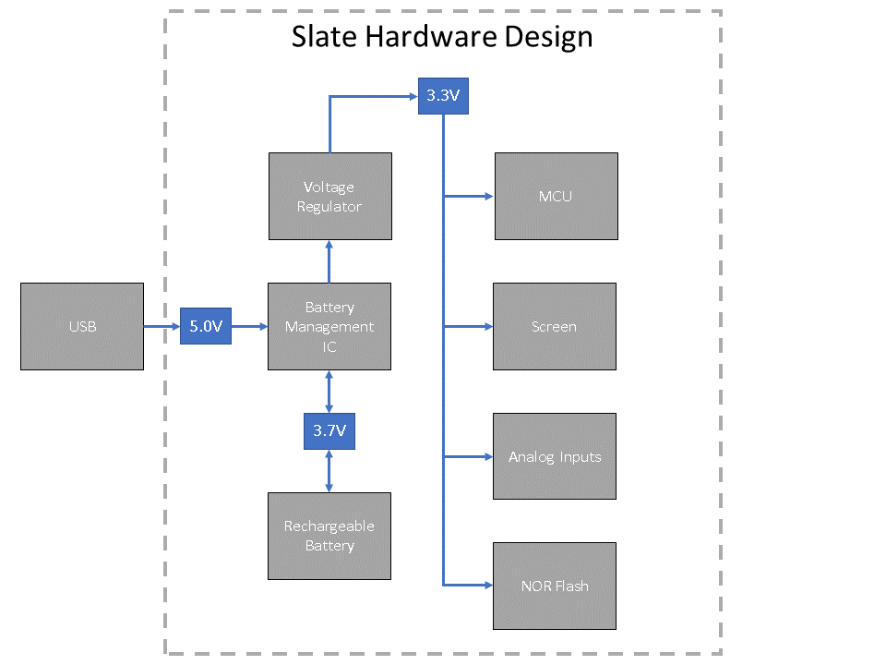
Hardware Block Diagram
Notes:
*Look at previous hardware design slide for start on script*
High-level block diagrams were created for hardware, and software designs during the initial stages of Slate. These early block diagrams ensured all team members had a similar vision for what would be necessary to accomplish the realization of the project.
As shown by the block diagram, The hardware for the design of Slate consists of six major components which include the battery management IC, voltage regulator, MCU, Screen, analog inputs and NOR flash. Power for Slate is provided from USB when available and via an internal battery when USB is not available.

Slide 9
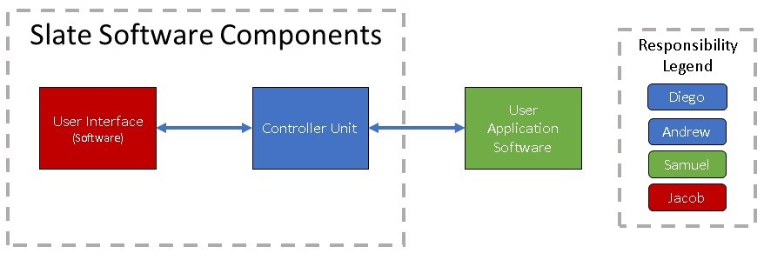
Software Block Diagram
Notes:
This is a diagram representing the major components of the software system. From this block diagram, the team was able to identify three key areas of Slate that would require software design and implementation. These three software areas are the user interface which is displayed on Slate's internal screen, the controller unit software which mainly manages the interface between the user and the device Slate is connected to, and the user application software which is used to configure Slate.
The responsibility legend was mainly used to identify the team member responsible for the initial investigation of what was required for each of these software components.

Slide 10
Strategic Part Selection

Slide 11
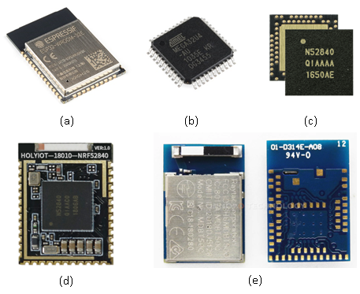
Microcontroller Selection
Controller | Native USB | Native Wireless | Fast Processor ( ≥≥ 32 MHz) | Large Flash Memory ( ≥≥ 1 MB) | ≥≥ 25 GPIO pins | CircuitPython Support
ATMega32U4 | ✓ |  |  |  | ✓
ESP32 |  | ✓ | ✓ | ✓ | ✓ | Only ESP32-S2
nRF52840 | ✓ | ✓ | ✓ | ✓ | ✓ | ✓
Controller | Processor | Speed | Flash | RAM | GPIO
ATMega32U4 | AVR 8-bit | 16Mhz | 32 KB | 2.5 KB | 25
ESP32 | Xtensa LX6 | Up to 240Mhz | 4MB | 320 KB | 34
nRF52840 | Arm M4F | 64Mhz | 1 MB | 256 KB | 48
Notes:
After reviewing the microcontrollers for consideration, our choice will be the Nordic Semiconductor nRF52840. It’s support for both native USB and Bluetooth will cut down on development time and complexity, plus it has all the speed needed to run this project and ample GPIO pins for our inputs.
**NEW**
After reviewing the microcontrollers for consideration, our choice was the Nordic Semiconductor nRF52840. It’s support for both native USB and Bluetooth cut down on development time and complexity, plus it has all the speed needed to run this project and ample GPIO pins for our inputs.

Slide 12
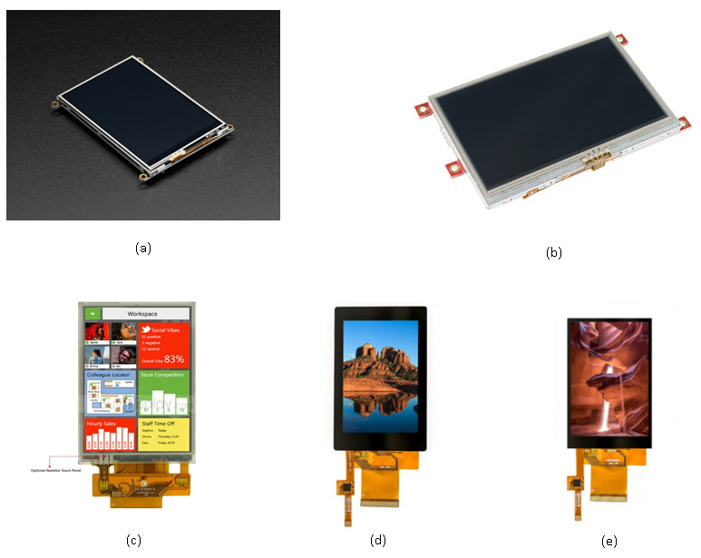
Touchscreen Selection
A)Adafruit TFT FeatherWing 3.5”
B)4D System uLCD-43PT
C)EastRising TFT LCD touchscreen
D)Focus LCD’s TFT E35RG73248LW6M250-C
E)Focus LCD’s TFT E35RG13248LW2M450-CA
Display Module | Brightness level | Serial Comm. Type | Resolution | Operating Power | Dedicated Touchscreen Controller
FeatherWing | 400 NITS | SPI | 480x320 | 3.3V logic 5.0V backlight | STMPE811
Breakout | 400 NITS | SPI Fast 8-bit parallel | 480x320 | 3.3V logic 5.0V backlight | N/A
Notes:
After reviewing the touchscreen options that we considered, we’ve decided on the Adafruit 3.5” TFT FeatherWing screen module shown in figure (a). The FeatherWing includes circuitry and components that assist in its operation and reduce number of pins required by the controller. The FeatherWing is also a good choice for development, which means we won’t have to change screen models from prototype to final design. We wanted a screen that both was bright enough and fast enough for the slate and the FeatherWing hit all the marks.
After reviewing the touchscreen options that we considered, we’ve decided on the Adafruit 3.5” TFT FeatherWing screen module shown in figure (a). The FeatherWing includes circuitry and components that assist in its operation and reduce number of pins required by the controller. We wanted a screen that both was bright enough and fast enough for the slate and the FeatherWing hit all the marks.

Slide 13
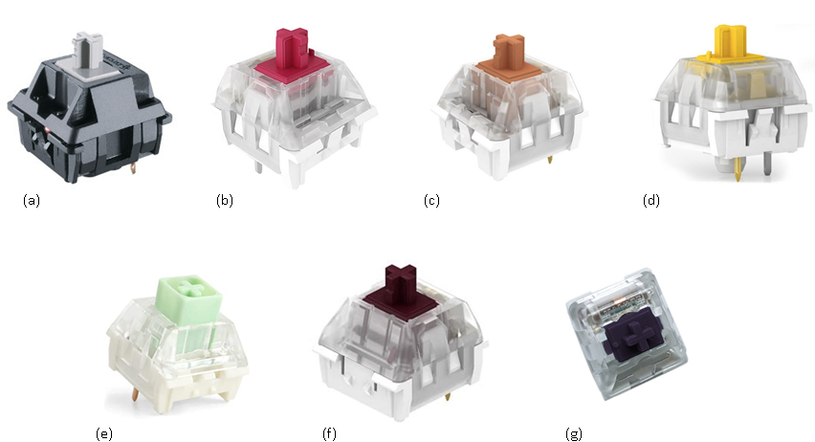
Switch Selection
 | Characteristics | Description
1 | Operation Force | How hard the user must press the key. It is measured in centinewton (cN) or gram-force (gf).
2 | Activation Point | This is the point where the keypress in recognized by the keyboard and is measured in millimeters.
3 | Total Travel Distance | The distance the keycap travels until it hits the upper housing of the switch. Which is the distance until you bottom out. Normally measured in millimeters.
4 | Tactile Position | Is where you feel the bump on tactile and clicky switches.
5 | Reset Point | Is the distance which the key is deactivated when released.
Key switch Type | Noise Level | Feel | Force Required
Linear | Quiet | Smooth | Varies
Clicky | Loud | Bumpy | Varies
Tactile | Moderate | Bumpy | Varies
Low-profile | Varies | Varies | Varies
Notes:
For our physical switches, we wanted the user to have clear and audible feedback when a switch is pressed. For this reason, we considered switches with varying characteristics. Given that the box Jade switch shown in figure (e) provides distinct tactile and audible feedback with greater stability vs. a non-box switch, we chose it for our final design.
+ However, we realized the Box Jade is not PCB mount, so we went with a tactile PCB mount switch instead that still gave a solid feel.

Slide 14
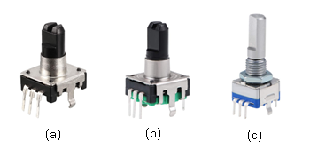
Rotary Encoder Selection
Encoder | Shaft Type | Shaft Length | Shaft Diameter | Total Dimensions | Switch?
Small (a) | D | 12.5mm | 6mm | 14.5x12.7x21mm | Yes
Medium (b) | D | 14.3mm | 6mm | 15x13x24mm | Yes
Large (c) | D | 20mm | 6mm | 15x12.5x30mm | Yes
Notes:
After reviewing all the rotary encoder models, our choice for the final design will be the medium 20mm rotary encoder because it provided a moderately slim profile.
***New script suggestion***
After reviewing all the rotary encoder models, our choice for the final design was the medium 20mm rotary encoder because it provided a moderately slim profile.

Slide 15
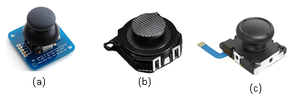
Joystick Selection
Joystick | Pins | Profile | Connector Required? | Switch?
PS2-Style (a) | 5 | Full | No | Yes
PSP-Style (b) | 4 | Slim | No | No
Switch-Style (c) | 5 | Slim | Yes | Yes
Notes:
For the joystick models that we considered, our choice for the final design will be the PS2-Style Joystick shown in figure (a) because in our testing it had great accuracy and it does not require a connector. In choosing the PS2-style joystick we can also utilize its button functionality for the Slate.
***New script suggestion***
For the joystick models that we considered, our choice for the final design was the PS2-Style Joystick shown in figure (a) because in our testing it had great accuracy and it does not require a connector. In choosing the PS2-style joystick we can also utilize its button functionality for the Slate.

Slide 16
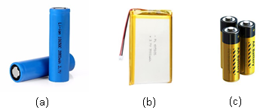
Battery Selection
Battery | Nominal Voltage per cell | Shape | Capacity Range per cell
Lithium-Ion (a) | 3.7 V | Cylindrical | 1800mAh – 3500mAh
Lithium-Polymer (b) | 3.7 V | Flat Rectangular | Depends on shape, 200mAh – 5000mAh
AA (c) | 1.5 V | Cylindrical | 2500mAh
Notes:
In choosing the type of battery we wanted to implement we chose a Li-Po battery because it was sufficient in meeting our power requirements of 3.3 V and comes preconfigured with a JST connector which is easy to implement into our board design.

Slide 17
Battery Management IC Selection
Consideration | MCP73831/2 | BQ24179 | MAX77757 | LTC4085
Manufacturer | Microchip | Texas Instruments | Maxim Integrated | Linear Technologies
Availability | Available | Available | Available | Available
Price (1 unit) | $0.66 | $6.36 | $2.86 | $4.41
Footprint | 2.0 x 3.0 mm | 2.90 x 3.30 mm | 3.0 x 3.0 mm | 4.0 x 3.0 mm
Package | DFN or SOT-34 | WCSP | FC2QFN | DFN
Charge Current | 15-500 mA | Up to 3.3 A | Up to 3.15 A | Up to 1.5 A
Thermal Feedback | Available | Available | Available | Available
Notes:
As for the selected Battery IC, the Microchip MCP73831/2 is what was chosen. The primary considerations that led to this design decision were the price, footprint, and package. We found the greatest weakness of our selection to be the small charge current which results in a longer time to reach full battery charge, however we found this tradeoff acceptable.

Slide 18
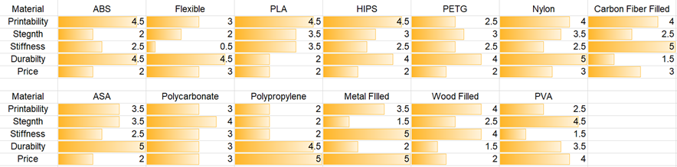
3D Printer Filament Selection
Notes:
Our choice of the 3D filament for the final design will be PLA because this filament type is already owned by a team member and these rolls are accessible from previous projects. This decision may change after the first iteration of testing our PCB design within the enclosure.
***new script suggestion***
Our choice of the 3D filament for the final design was PLA because this filament type is already owned by a team member and these rolls are accessible from previous projects.

Slide 19
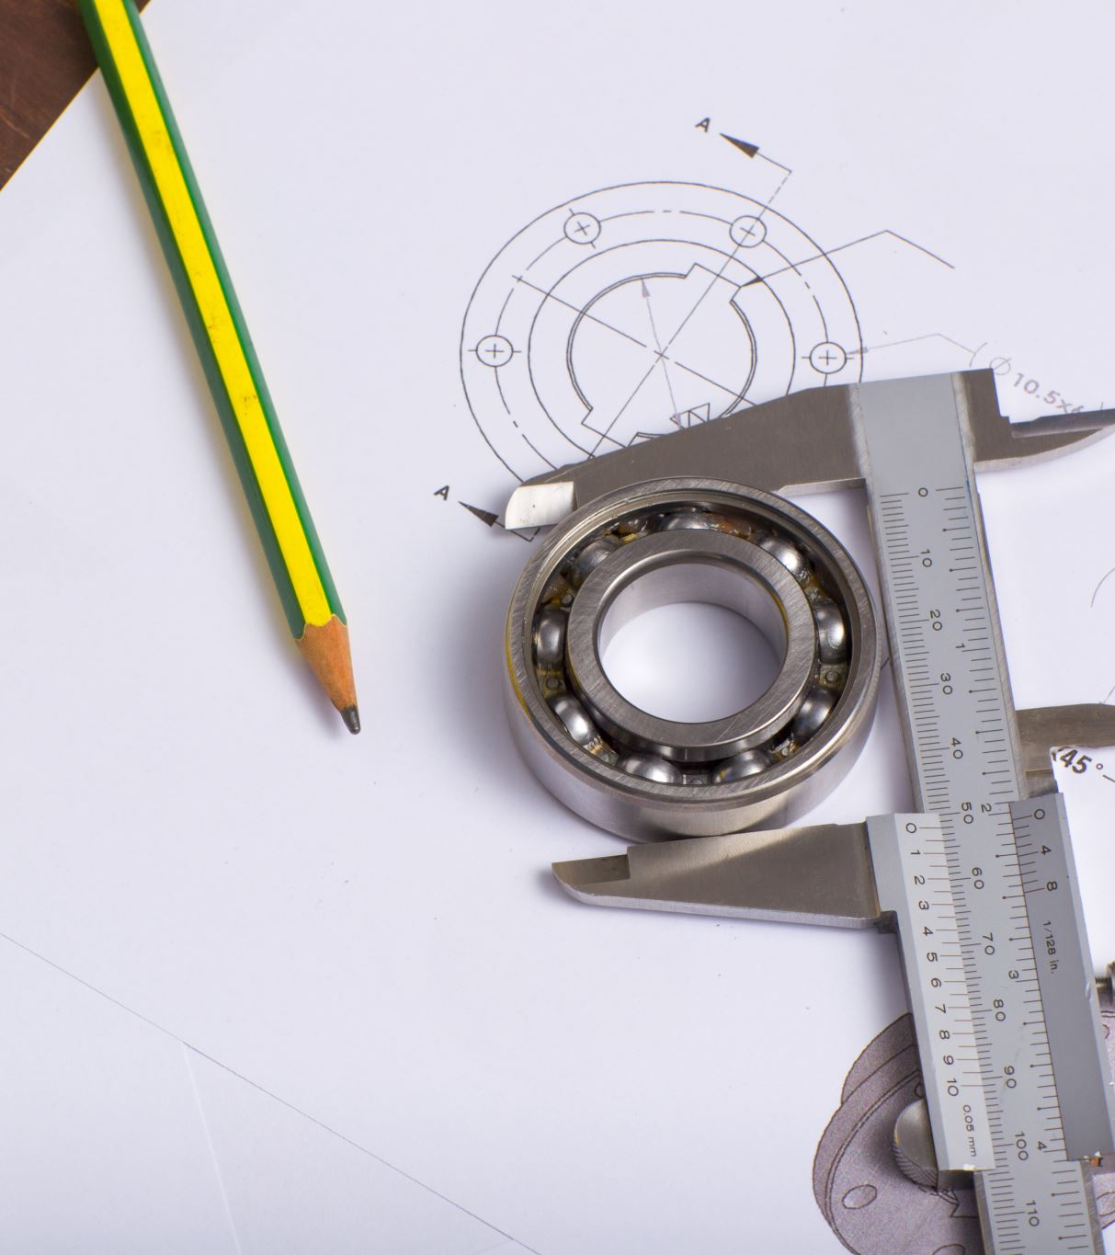
Hardware Design Details

Slide 20
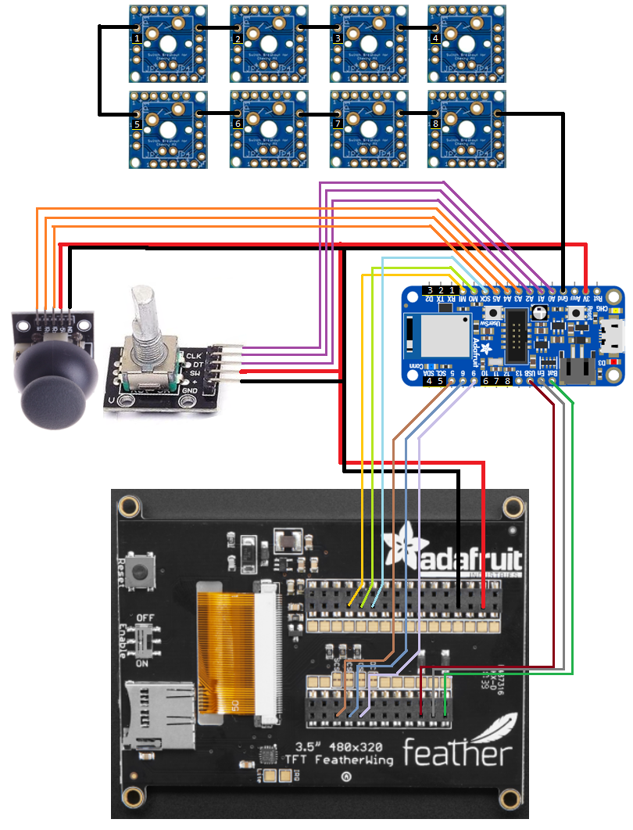
Prototype Concept
Notes:
After the studying all these component’s datasheets, and other related designs that utilized these components, a diagram was developed to aid in the net connections that would be used in Eagle. The following figure has color coded lines showing the now known connections between all these key components.

Slide 21
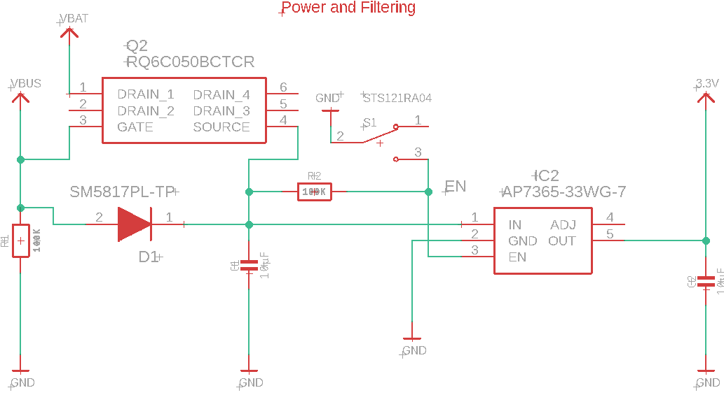
Power and Filtering Design Details
Notes:
This image shows the design for the power and filtering circuit. The diode labeled d1 allows for the circuit to choose whether to use USB or battery as its voltage source. As well as a power switch labeled s1. A pull-up resistor is used on the ENABLE pin of the IC to activate voltage regulation. The result of the circuit is a regulated 3.3V output that is used to provide voltage to the rest of the system.

Slide 22
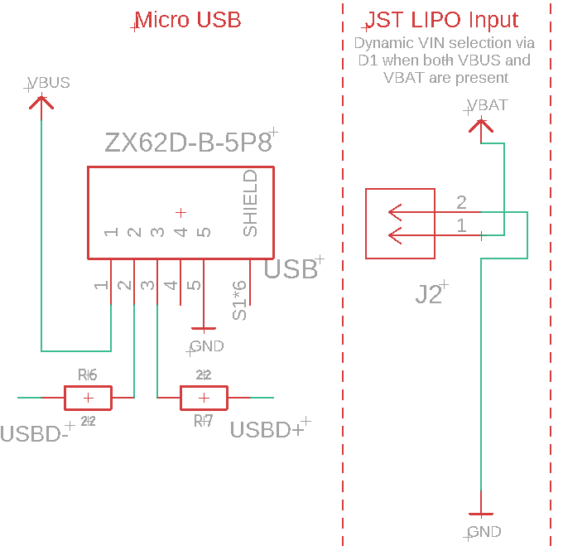
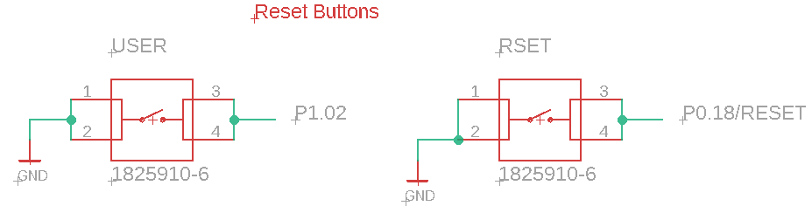
USB, JST LIPO Connectors & Reset button
Notes:
This portion of the schematic includes the design for the Micro USB, JST connector that interfaces with the battery, and a reset button for the MCU and screen. Slate will be utilizing a USB 2.0 Micro connector to provide data transfer and power when it is connected. When the battery is the only power source, the LIPO monitoring circuit in the next section will automatically switch from the 5.0V USB input from VBUS to the voltage provided by VBAT.
***New script suggestion***
This portion of the schematic includes the design for the Micro USB, JST connector that interfaces with the battery, and a reset button for the MCU and screen. Slate utilizes a USB 2.0 Micro connector to provide data transfer and power when it is connected. When the battery is the only power source, the LIPO monitoring circuit in the next section automatically switches from the 5.0V USB input from VBUS to the voltage provided by VBAT.

Slide 23
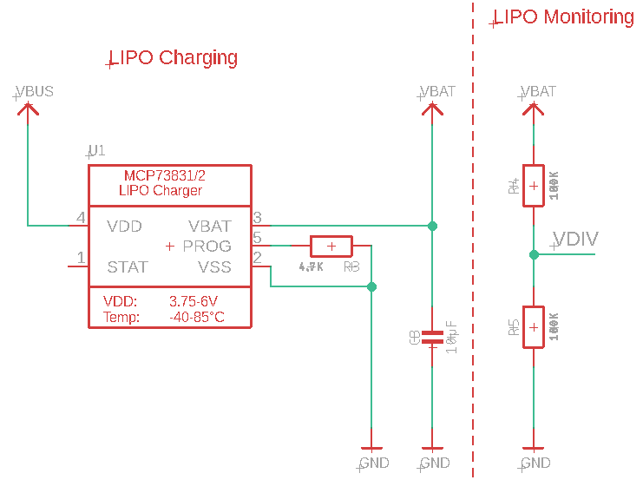
LIPO Charging & Monitoring
Notes:
The circuits responsible for the LIPO battery charging and monitoring are shown here. The STAT pin of the LIPO charger is left disconnected as there will be no LED indicator on the final PCB design of Slate. The LIPO monitoring circuit’s voltage divider will be connected to a GPIO pin of the MCU to monitor the battery percentage. From the datasheet we know that VDD needs to be between 3.75V and 6.0V, which is satisfied by the provided voltage from USB (VBUS). And the required temperature range will fall into our range od operation stated eariler in the engineering requirements for slate
***New script suggestion***
The circuits responsible for the LIPO battery charging and monitoring are shown here. The STAT pin of the LIPO charger is left disconnected as there is no LED charging indicator on the final PCB design of Slate. The LIPO monitoring circuit’s voltage divider is connected to a GPIO pin of the MCU to monitor the battery percentage. From the datasheet we know that VDD needs to be between 3.75V and 6.0V, which is satisfied by the provided voltage from USB (VBUS). And the required temperature range will fall into our range of operation stated earlier in the engineering requirements for slate

Slide 24
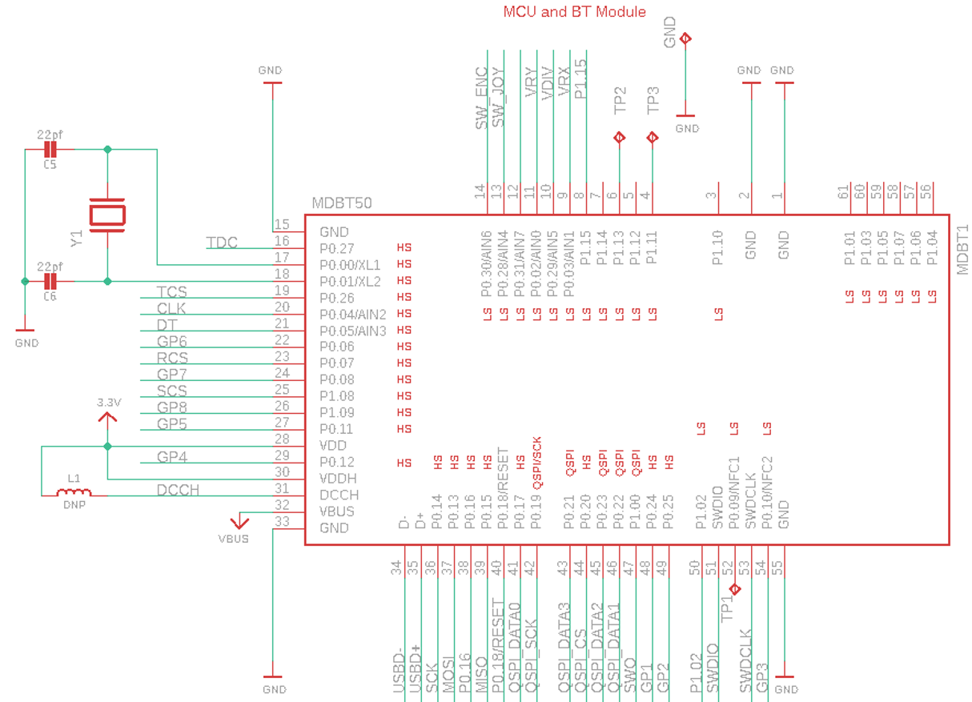
MCU/BT Module
Notes:
The following slide shows the design for the MCU/BT module. Test points are included on the MCU to aid in tracking down any potential problems. Some pins to point out that shows our naming conventions are SW_ENC and SW_JOY. These nets are associated with the switches for both the encoder circuit and the joystick circuit respectively. Similarly, the nets that begin with QSPI are those that need to be connected to the memory module that utilizes QSPI for serial communication.

Slide 25
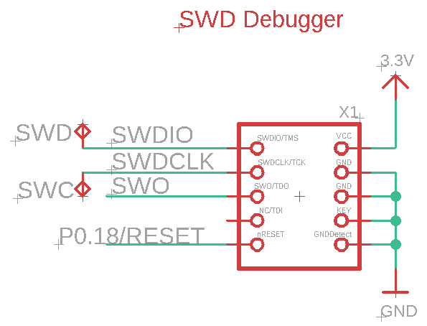
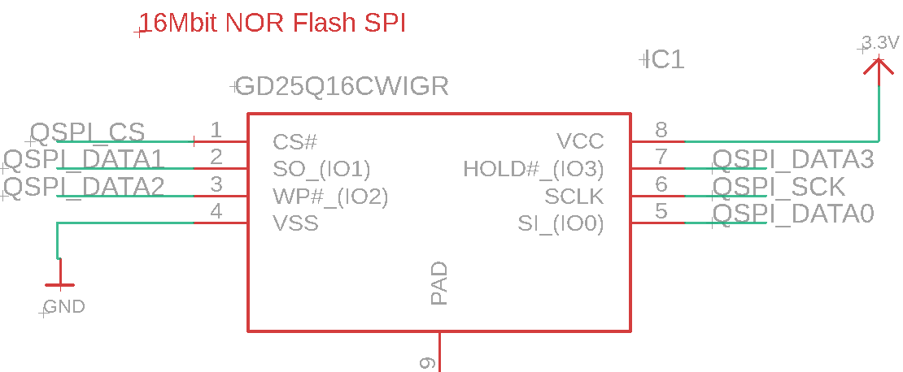
SWD Debugger & Flash Memory
Notes:
This slides shows the schematic design for the SWD debugging interface and the flash memory. Test points are included on the debugging circuit, like those found on the MCU schematic previously, that will aid in any necessary debugging of the PCB design. The SWD circuit is a standardized connector that will be necessary to flash the MCU with the required bootloader.
***New script suggestion***
This slides shows the schematic design for the SWD debugging interface and the flash memory. Test points are included on the debugging circuit, like those found on the MCU schematic previously, this aided in any necessary debugging of the PCB design. The SWD circuit is a standardized connector that was used to flash the MCU with the required bootloader.

Slide 26
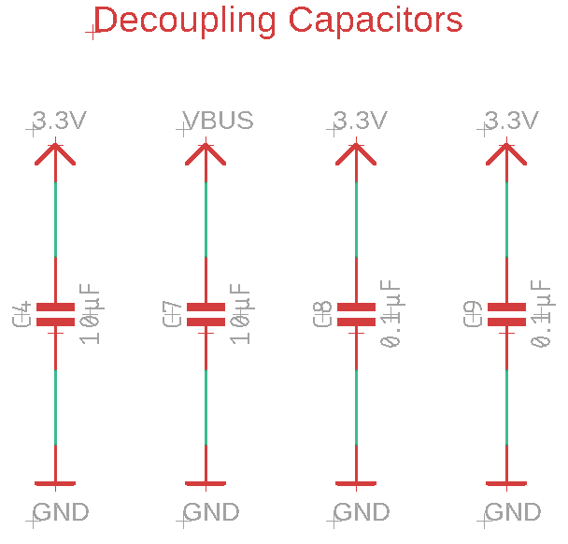
Decoupling Capacitors
Notes:
Several capacitors are used and placed near the ICs that are included in our design. These capacitors act as shunts against noise caused by the other components in the design.

Slide 27
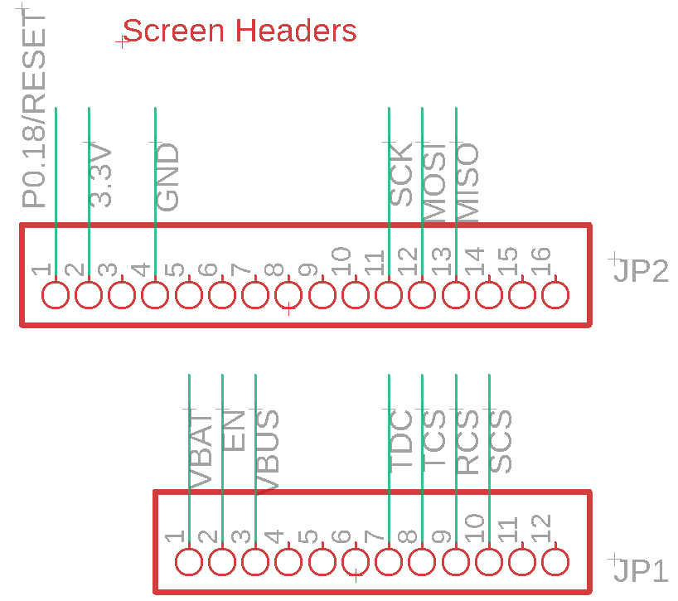
Screen Headers
Notes:
Two pin headers placed parallel to each other are planned to be utilized to connect the screen to the MCU and power nets of the rest of the PCB. As shown here not all pins on the connectors of the screen are utilized. Those pins that are unnecessary are left without any nets connecting to them. The aspects of this portion of the design were heavily influenced by the layout of the selected screen.
***new script suggestion***
Two pin headers placed parallel to each other are utilized to connect the screen to the MCU and power nets of the rest of the PCB. As shown here not all pins on the connectors of the screen are utilized. Those pins that are unnecessary are left without any nets connecting to them. The aspects of this portion of the design were heavily influenced by the layout of the selected screen.

Slide 28
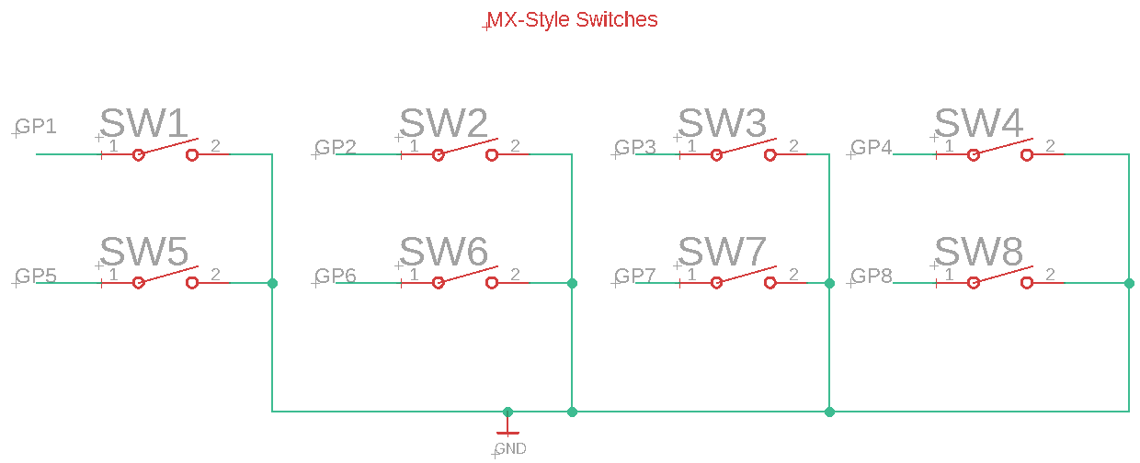
MX Switches
Notes:
The Slate prototype will use eight MX switches as a 2X4 matrix which is shown here. The nets connecting to pin 1 of the switches corresponds to a GPIO pin on the MCU.
***new script suggestion***
The final version of Slate’s PCB uses eight MX switches as a 2X4 matrix which is shown here. The nets connecting to pin 1 of the switches corresponds to a GPIO pin on the MCU.

Slide 29
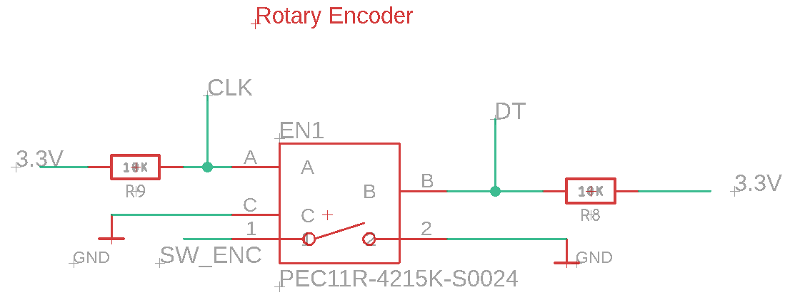
Rotary Encoder
Notes:
The following slide shows the design for the rotary encoder, which was heavily inspired by the recommended layout provided in the datasheet.

Slide 30
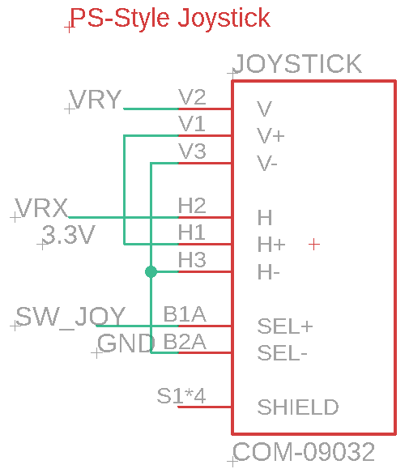
Joystick
Notes:
This shows the deign for our PlayStation style joystick, VRY add VRX correspond to the current position of the joystick.

Slide 31
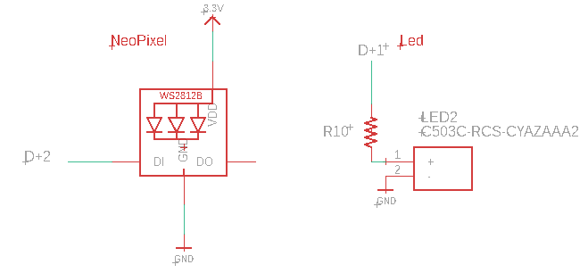
Debugging LEDs

Slide 32

PCB Design

Slide 33
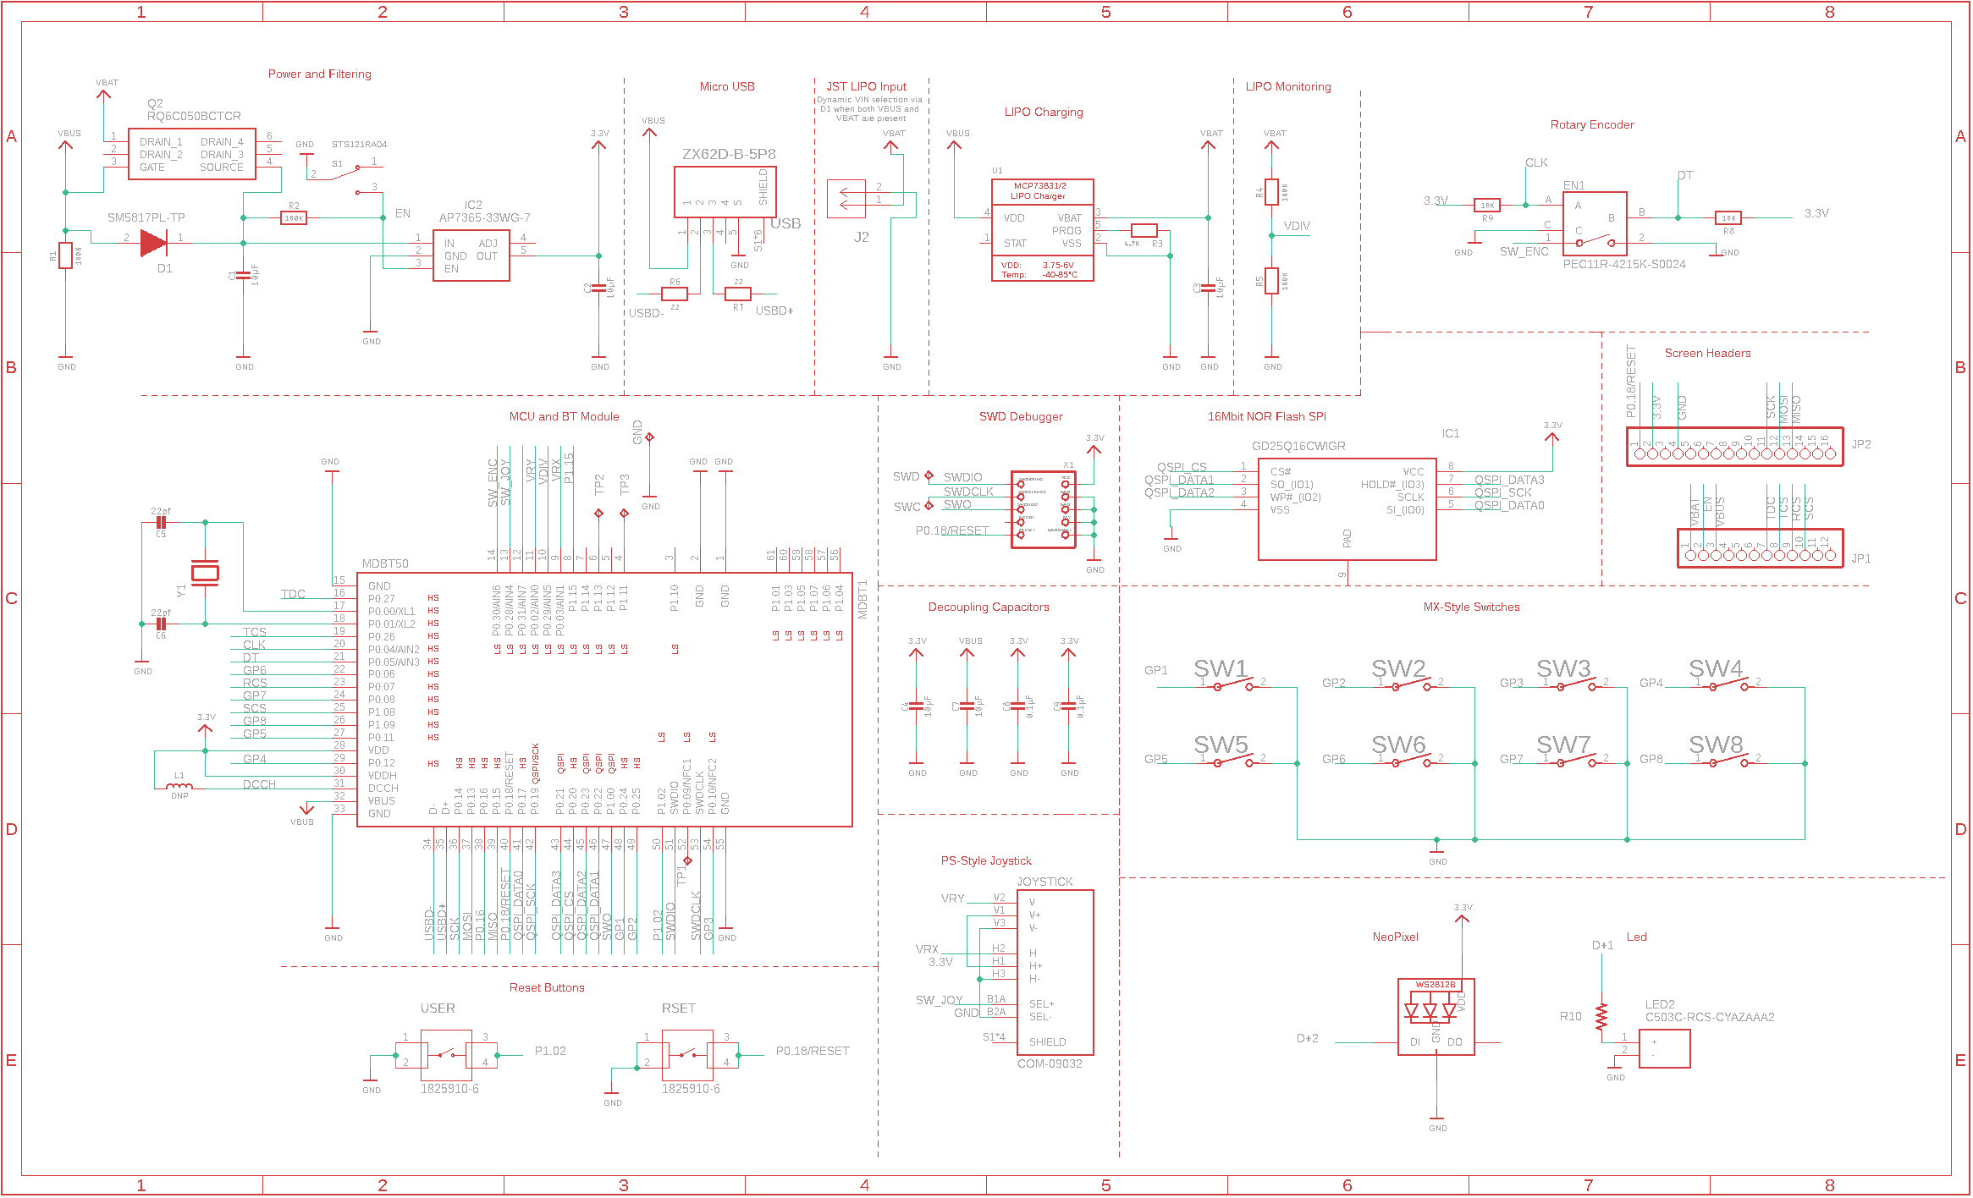
Notes:
The following image is the schematic in its entirety based off every portion described in the previous slides.

Slide 34
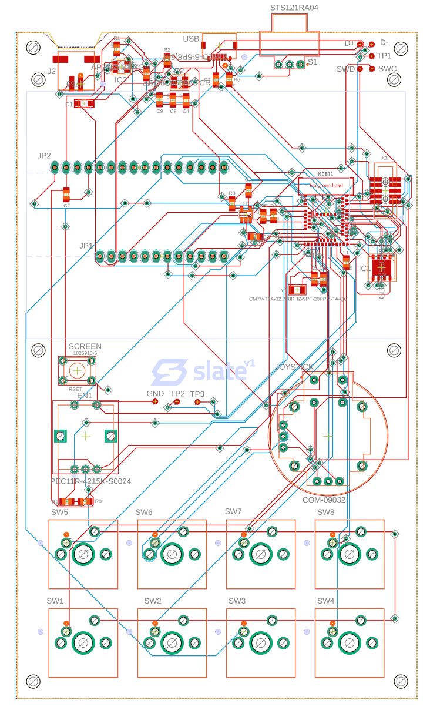
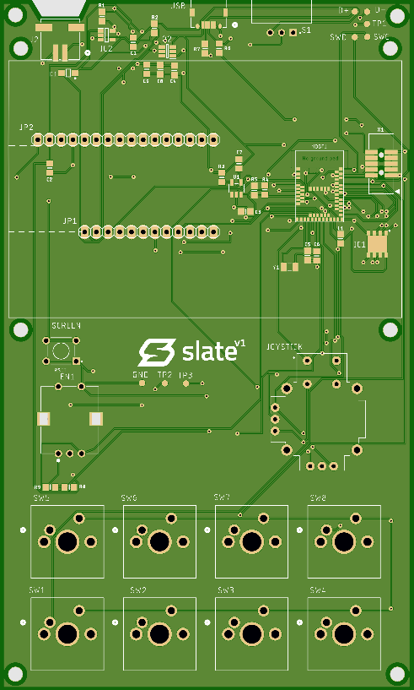
PCB v1 Layout
Notes:
This is slates current and possibly final design for the PCB Board layout. We choose to sperate the board into different sections, the top being the power and filtering with the JST connector for the on board battery, usb communication, charging, and power switch. It also holds the test points to help debug problems. The middle is where the screen headers lie as well as well as the MCU and all the passive components that are reflected in our schematic. It also holds the reset button. The bottom is where the sensors and switches lie. The 2 x 4 matrix of switches, joystick and encoder.
***new script suggestion***
This is Slate’s first iteration of the PCB Board layout. We chose to sperate the board into different sections, the top being the power and filtering with the JST connector for the on board battery, usb communication, charging, and power switch. It also holds the test points to help debug problems. The middle is where the screen headers lie as well as well as the MCU and all the passive components that are reflected in our schematic. It also holds the reset button. The bottom is where the sensors and switches lie. The 2 x 4 matrix of switches, joystick and encoder.

Slide 35
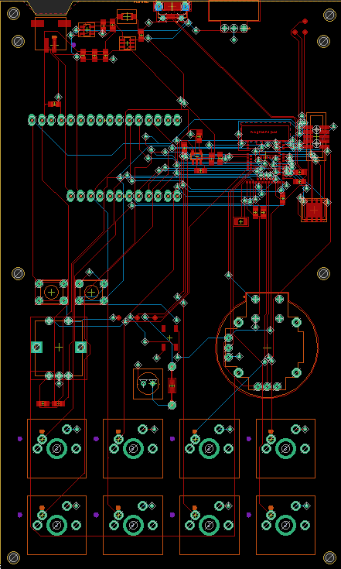
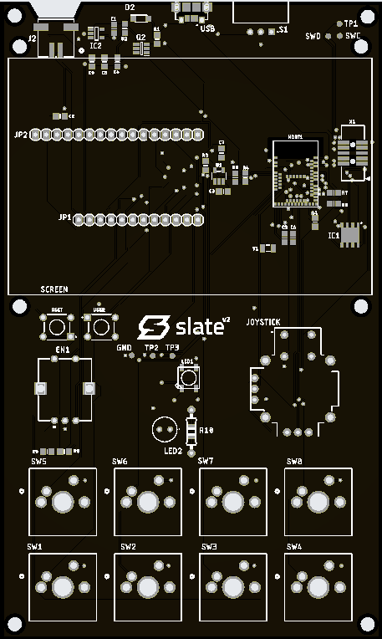
PCB v2 Layout
Notes:
This is slates revision 2 design for the PCB Board layout.
For this revision we changed the color to a sleek black color instead of green, we corrected issues with our USB connection orientation, USB data lines, added more test points. we also added an addition user select button, and two led place holders if we choose to use them, it also fixed battery jst connector being swapped, and ajusted the screen mounting holes to ensure better fitment.. The main difference between this board from our first iteration is the USB data lines.
***talk about some of the major changes between rev1 and rev2***

Slide 36

Software Design Details
Notes:
In this section we’ll discuss the Software Design for Slate, including languages, tools, block diagrams of software operation, and the overall strategy we’ll be using to achieve our project goal.

Slide 37

Software Design approach
CircuitPython
Easy to learn
Rapid development
Open-source, with a community of open libraries
Three Software Components
Configurator App Config File Slate Software
Simple User-Interface
Buttons easily identifiable and pressed
Easy navigation between layers
Low latency between input and macro execution
Writes
Read by
Notes:
The backbone of Slate’s internal software is CircuitPython, which is a lightweight version of the Python interpreter meant to run in embedded applications. Because we can develop in the Python language, our development time is decreased dramatically while using existing open-source libraries to assist in functionality.
Our design includes three components: a desktop app giving the user a GUI to map macros to each input type and customize as desired, a config file written by this app that can be parsed by Slate, and the software on Slate itself which maintains internal function and status while reading and executing the customizations set by the user. Overall, we want to provide a simple user-interface that allows the user to perform the tasks they want accelerated with ease.

Slide 38
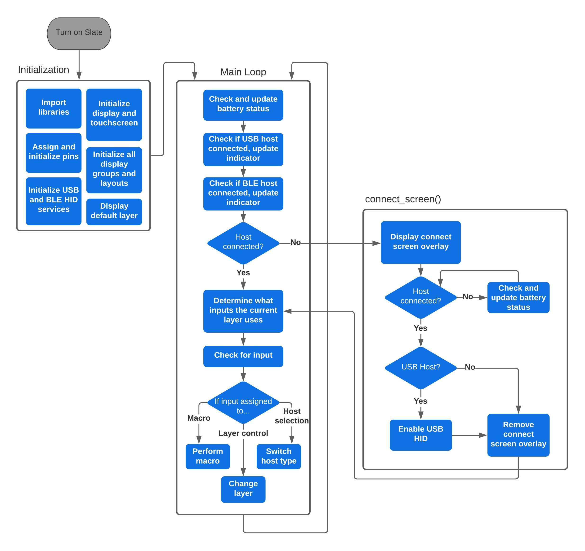
Slate’s Software Block Diagram
Notes:
Here you’ll see a diagram of the Slate internal software process as it runs on our MCU and takes in user input. When the user turns Slate on, it begins to import libraries and initialize peripheral components, HID services for USB and Bluetooth, defines the layout of the UI, and loads the first layer before entering the main loop. Once in the main loop, Slate will check battery status and host connection. If no host is detected, a connect screen will overlay the interface and wait until USB or Bluetooth is connected. If a host is connected, the Slate proceeds to check for user input and runs the macro or function assigned to any active input. This loop continues until the device is powered off, or a new config is written.

Slide 39
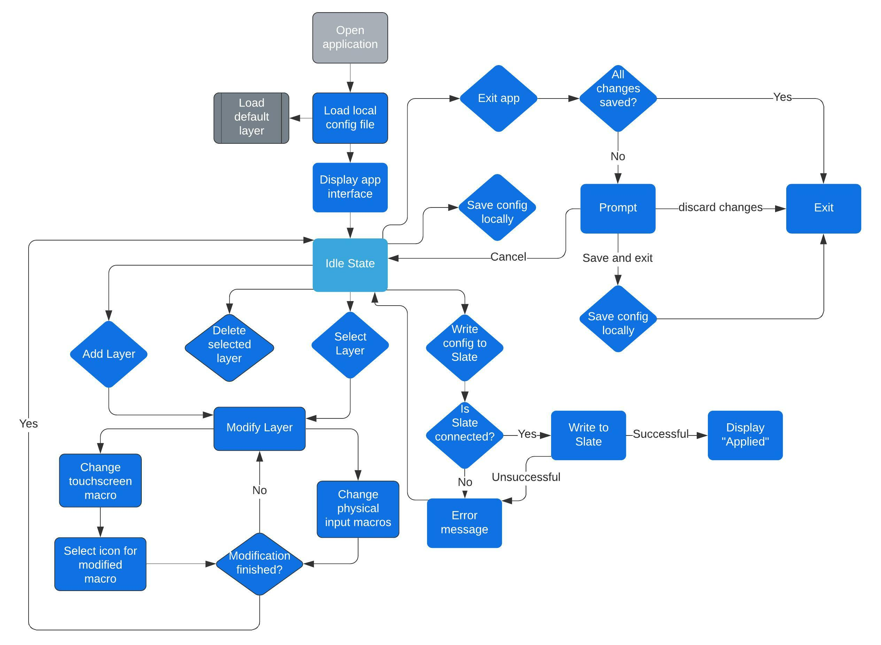
Desktop Configurator Block Diagram
Notes:
In this diagram we show the flow the configurator application can take as the user adjusts layers and eventually writes customizations to the keypad. Since the on-board Slate software and the config file is written in Python, the configurator app is also written in Python to maintain consistency and minimize extra time needed to familiarize with a different language.

Slide 40
Miscellaneous Software Tools
Documentation & Communication
OneDrive
Discord
Trello
Software Development Tools
Git
GitHub (https://github.com/goodmancode/slate-keypad)
CircuitPython
Mu Editor
VS Code
Qt Designer
Notes:
For our class-related files we’ve set up a shared OneDrive where we can collaborate in real-time on documents and presentations. Most of our communication is done through Discord where we conduct meetings, share files, links, and post progress. Additionally, we’ve used Trello to help Kanban our progress throughout Senior Design 1 and 2. Here we also list our main tools for software development. We are using version-control through GitHub with a public repository, and for editing code we use VS Code or Mu Editor which supports CircuitPython serial output from the board. Qt Designer is being used to implement the GUI design of our configurator app.

Slide 41
PCB Design Software Selection
Software Package | Specs | Price
Eagle Standard | 99 sheets with unlimited layers | $820
DipTrace Standard | 1000 pins with unlimited layers | $345
Eagle Free Version | 16 layers maxed at 4” x 6” boards | Free
DipTrace Free Version | 2 layers with a max of 500 pins | Free
OrCAD Free Version | 2 layers with a max of 100 pins | Free
Notes:
And finally, regarding PCB Design software, we decided that out of what’s available, Eagle was the one to utilize because it gives us the most flexibility in terms of max layers and size out of all the free options. Our group members were also more familiar with Eagle than the rest of the available software.

Slide 42
Prototyping
Notes:
This section documents the prototype progress, including hardware, Slate software and configurator software current implementation.

Slide 43
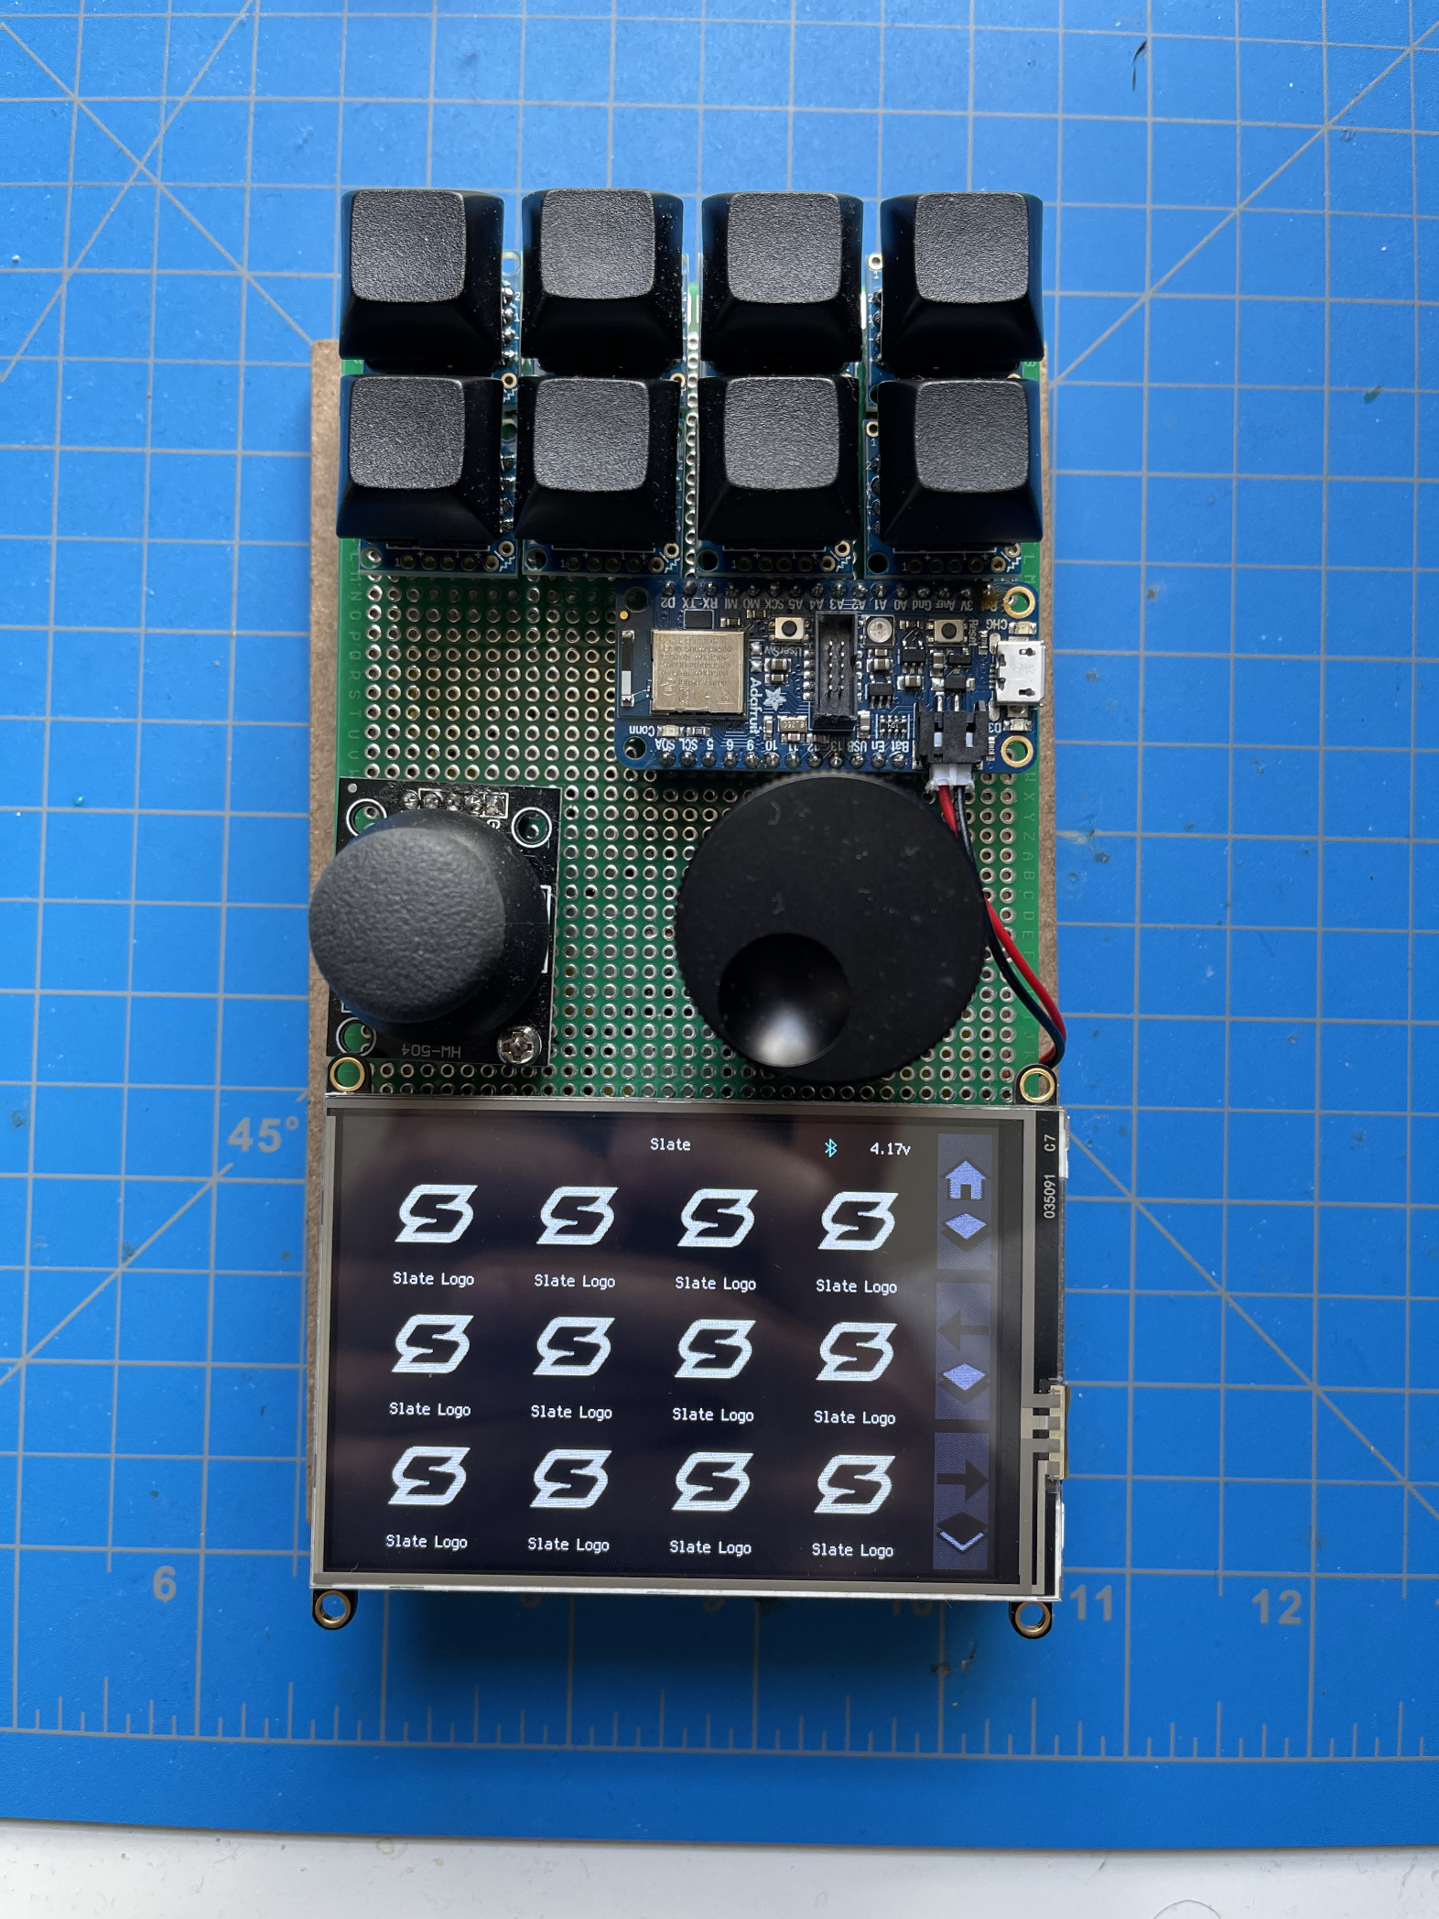
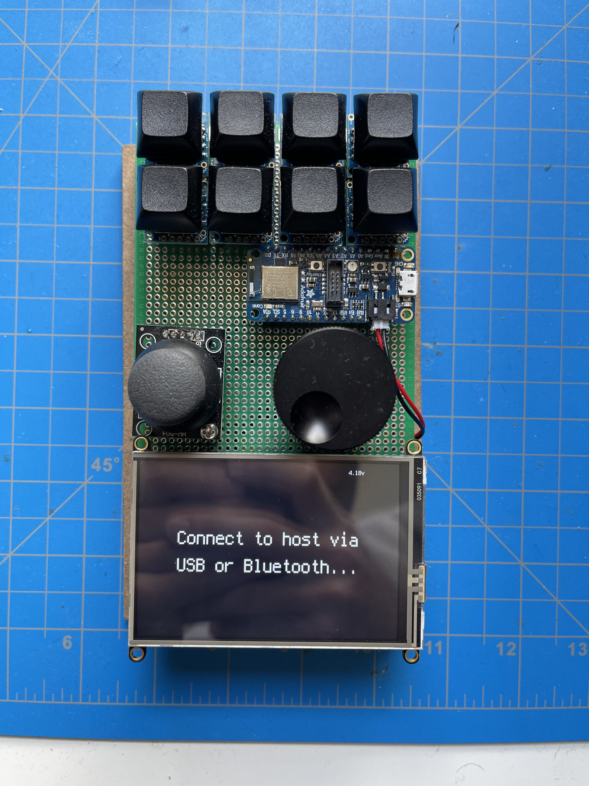
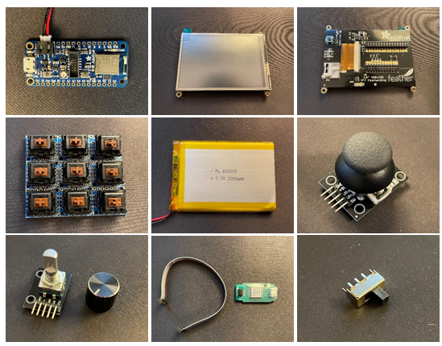
Hardware Prototype
Notes:
Here you can see images of our prototype board which has components connected and similarly laid out to how we intend the final design to look. Each component was inspected and tested for functionality prior to being assembled into our prototype. These images also show a build of our on-board software which we’ll discuss next.
***New audio suggestion***
Here you can see images of our prototype board which has components connected and similarly laid out to how we intended the final design to look. Each component was inspected and tested for functionality prior to being assembled into our prototype. These images also show a build of our on-board software which we’ll discuss next.

Slide 44
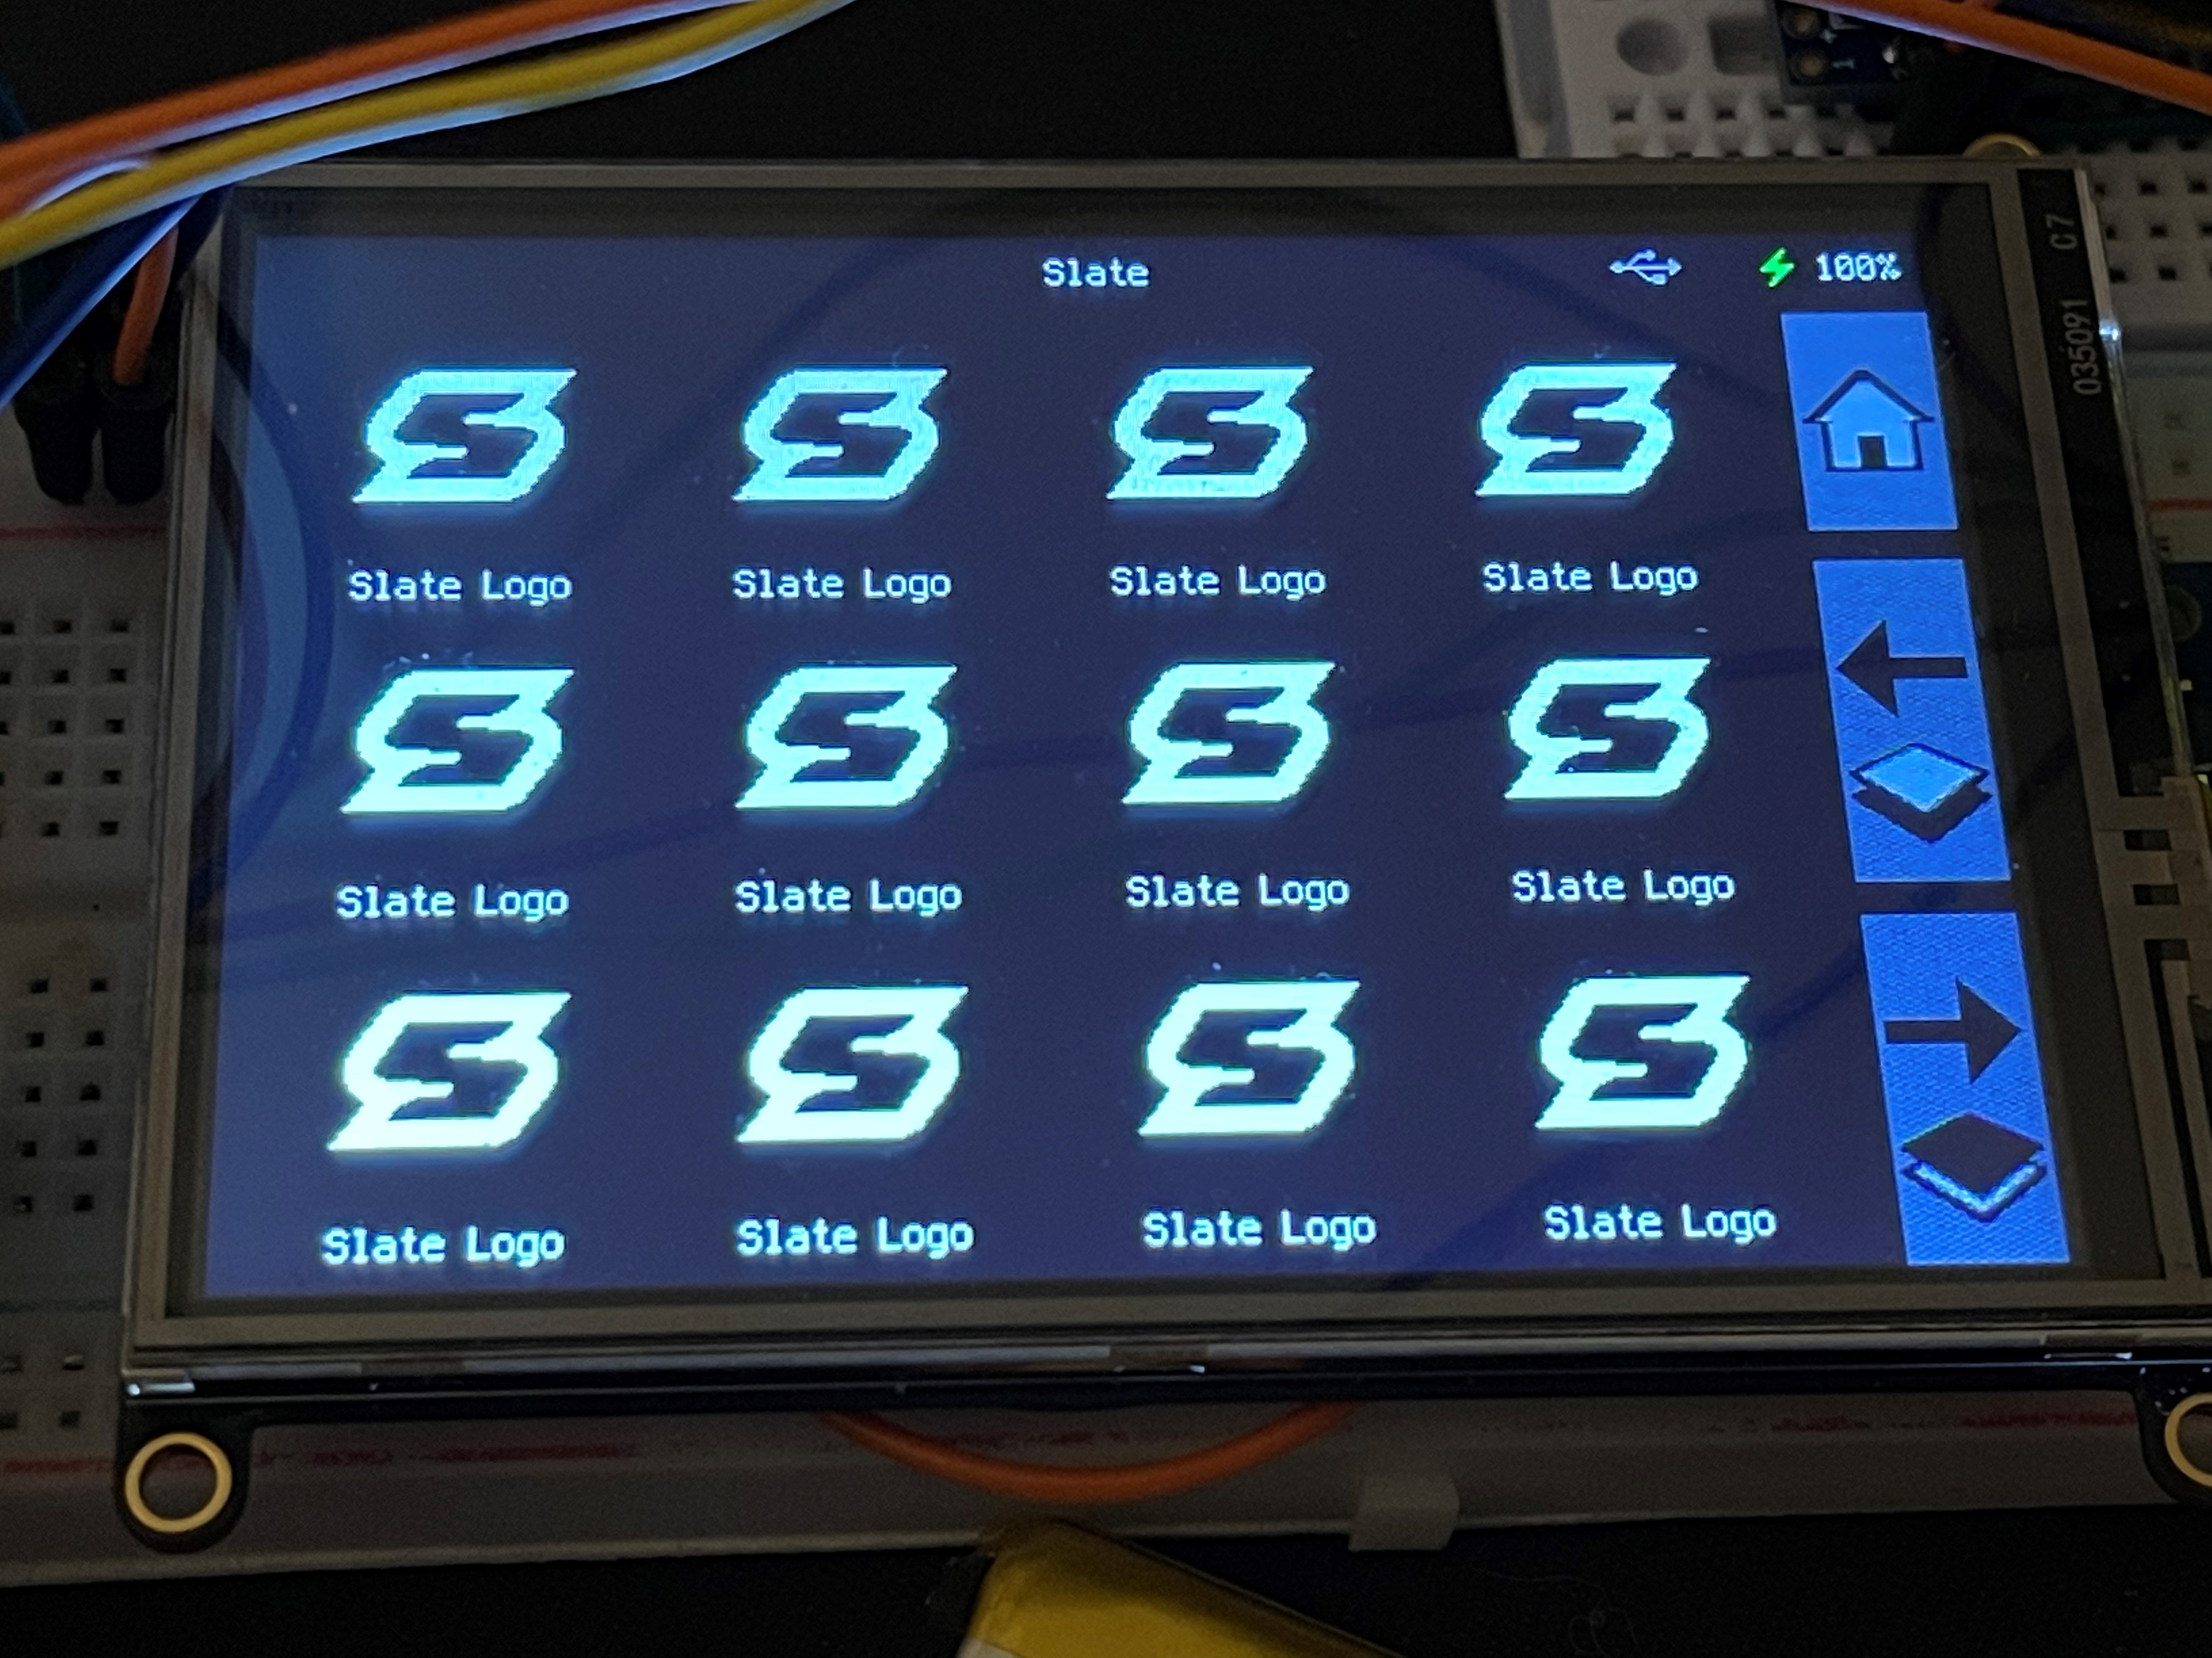
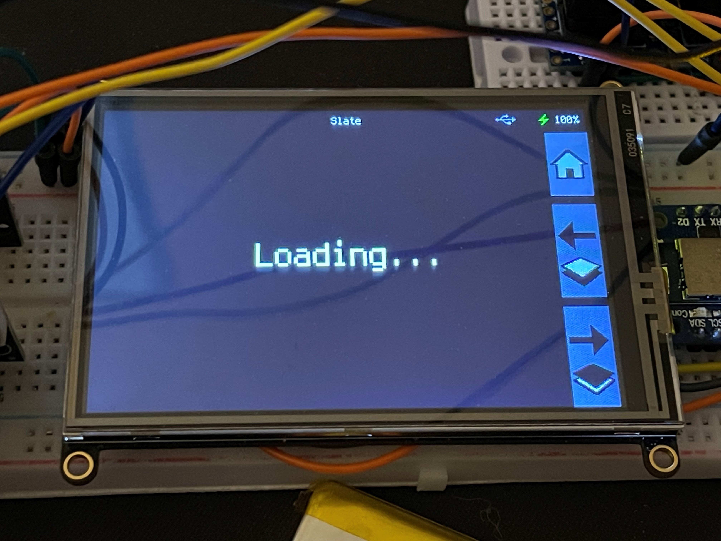
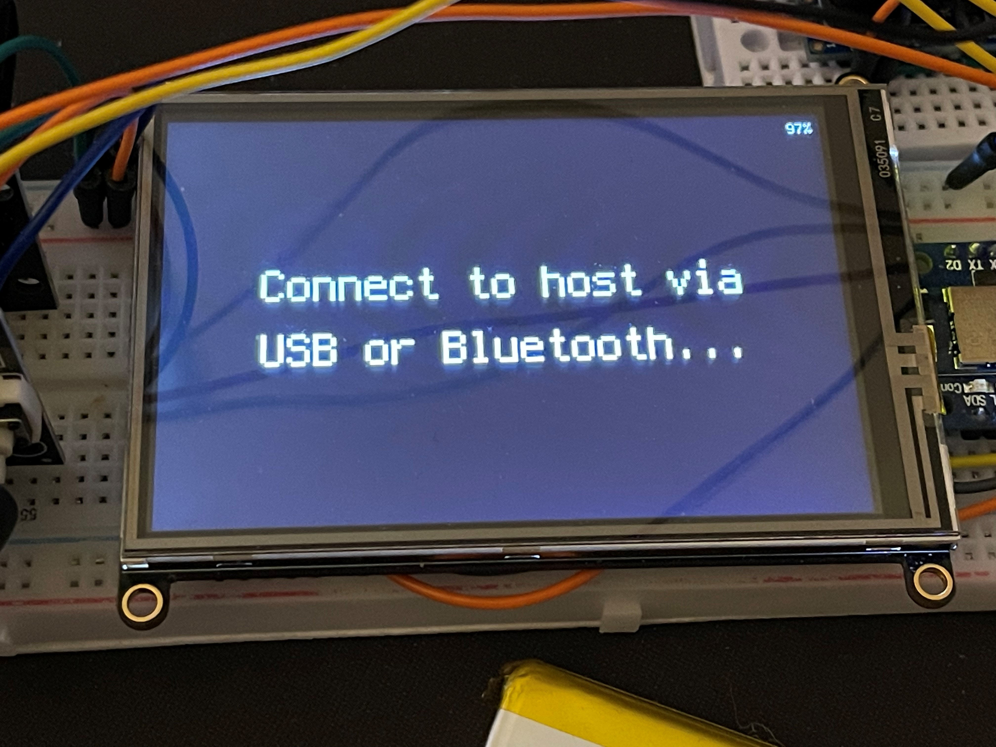
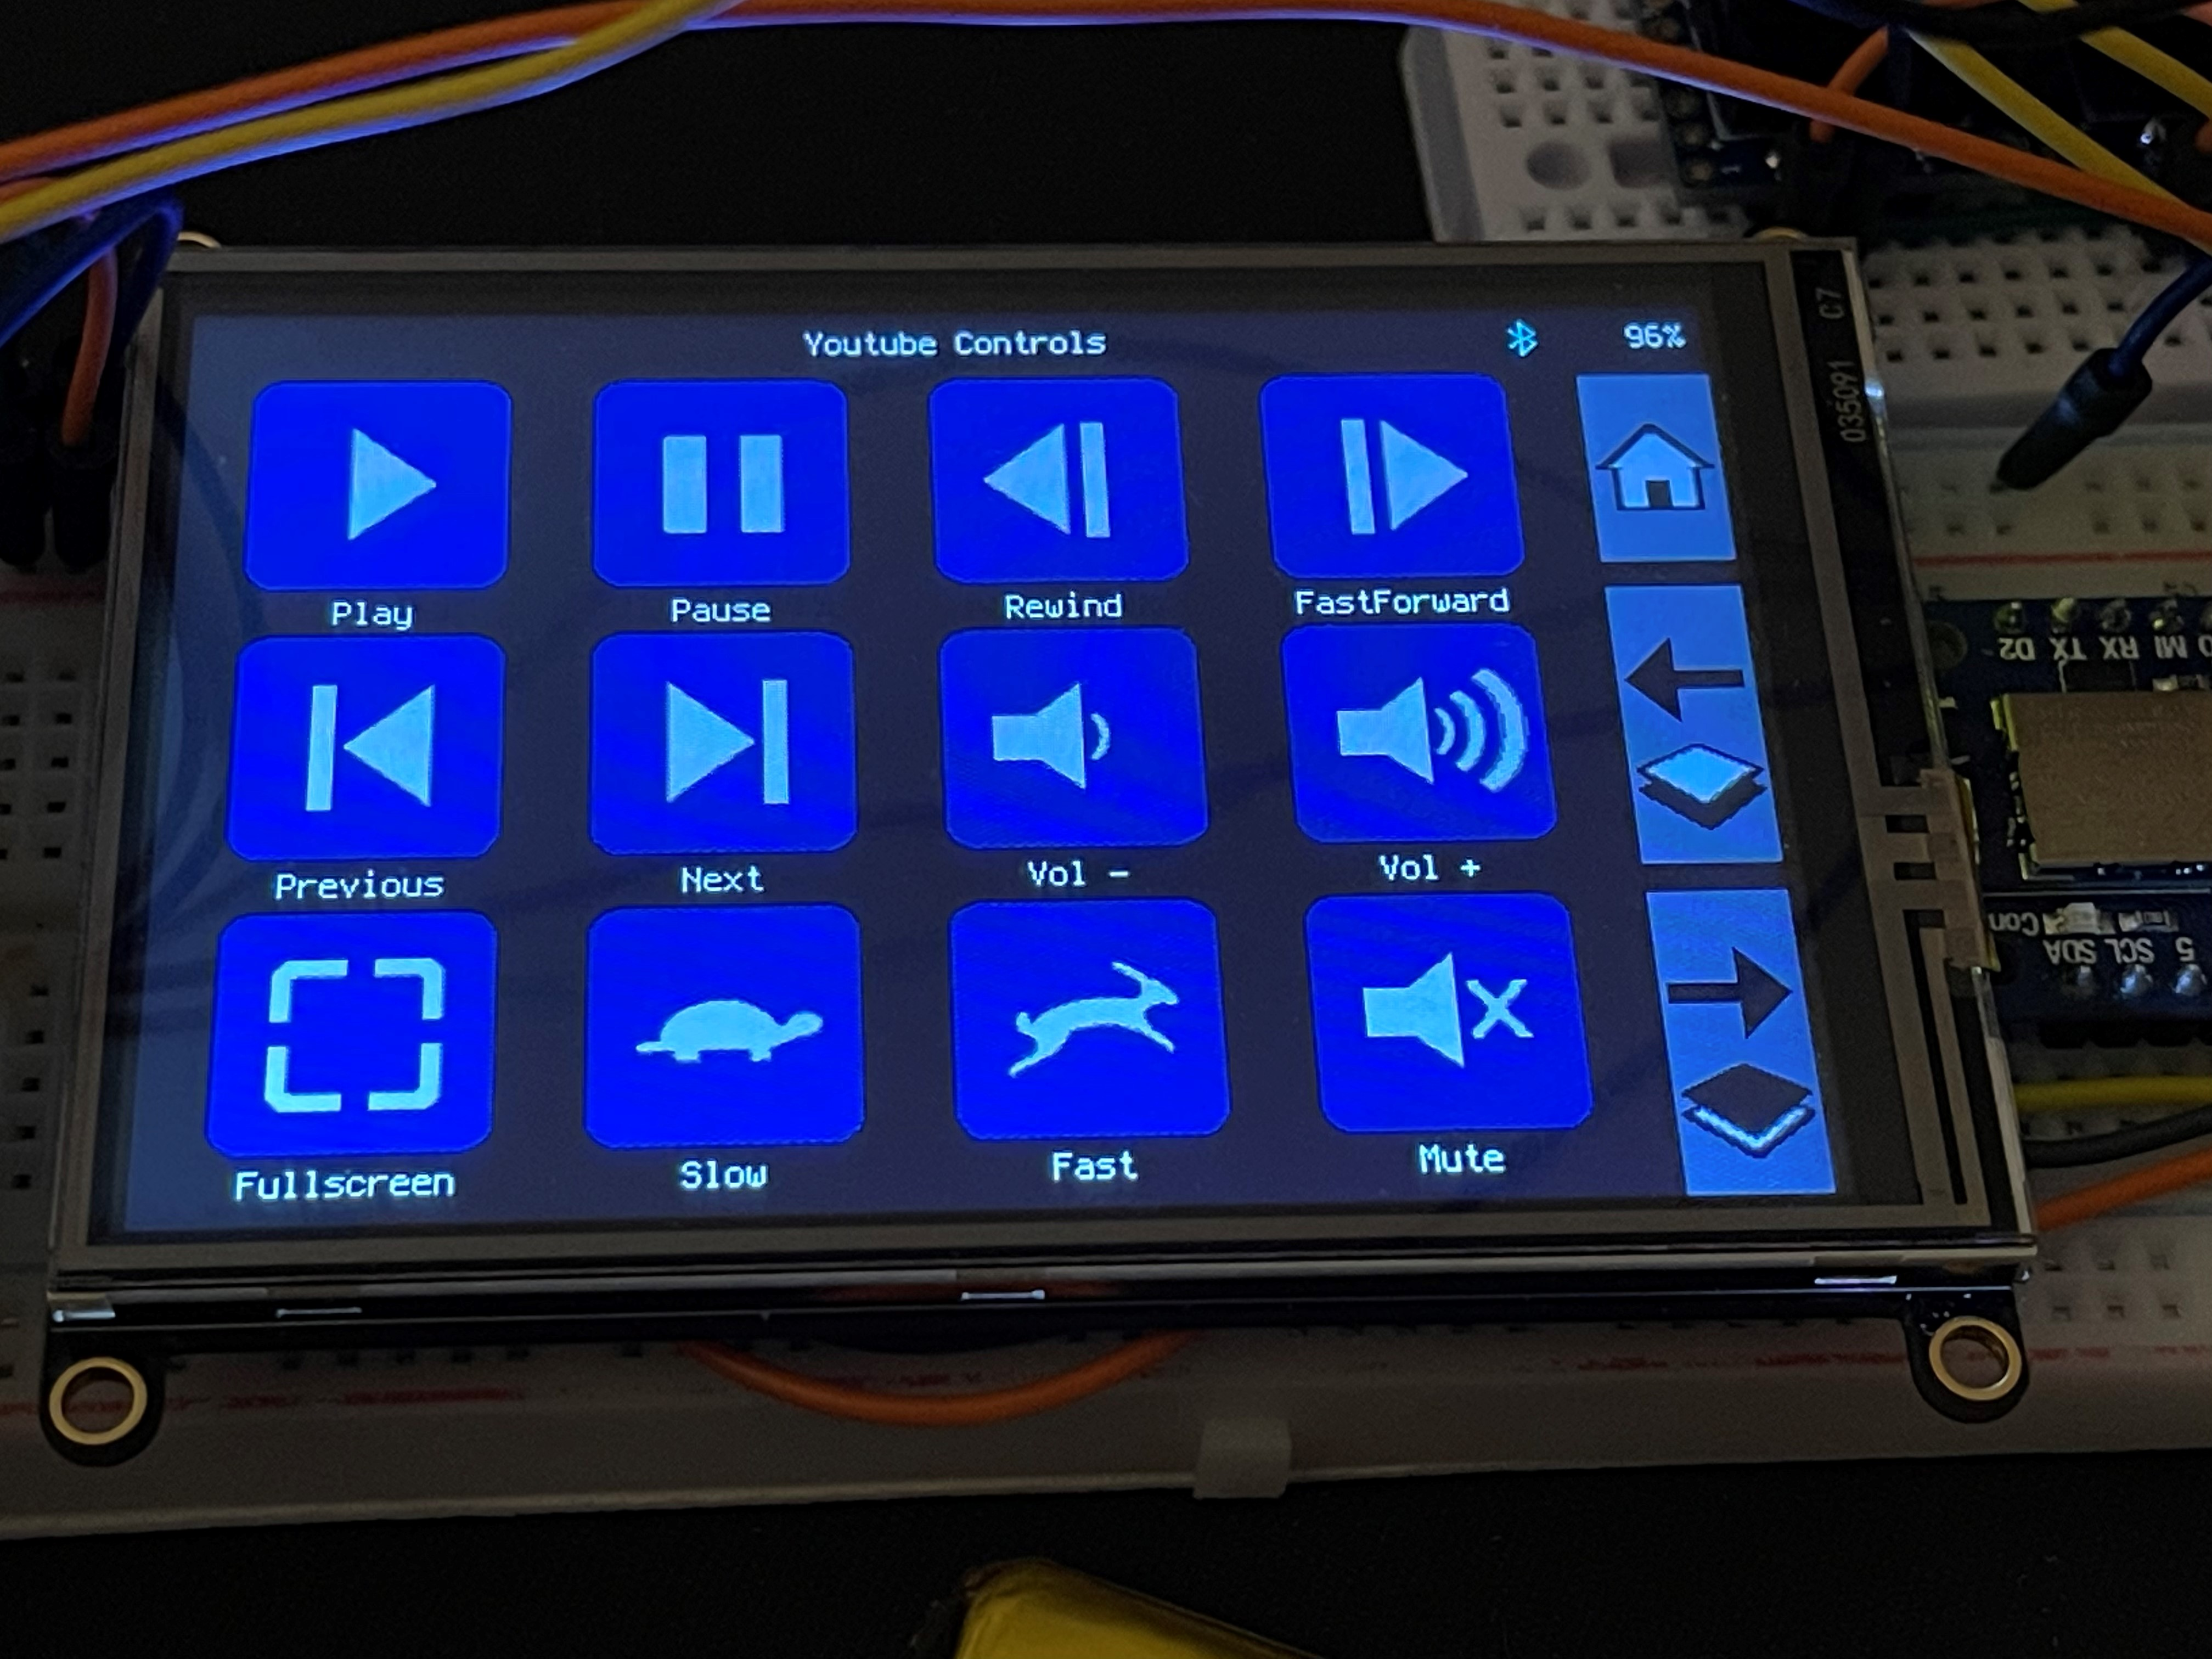
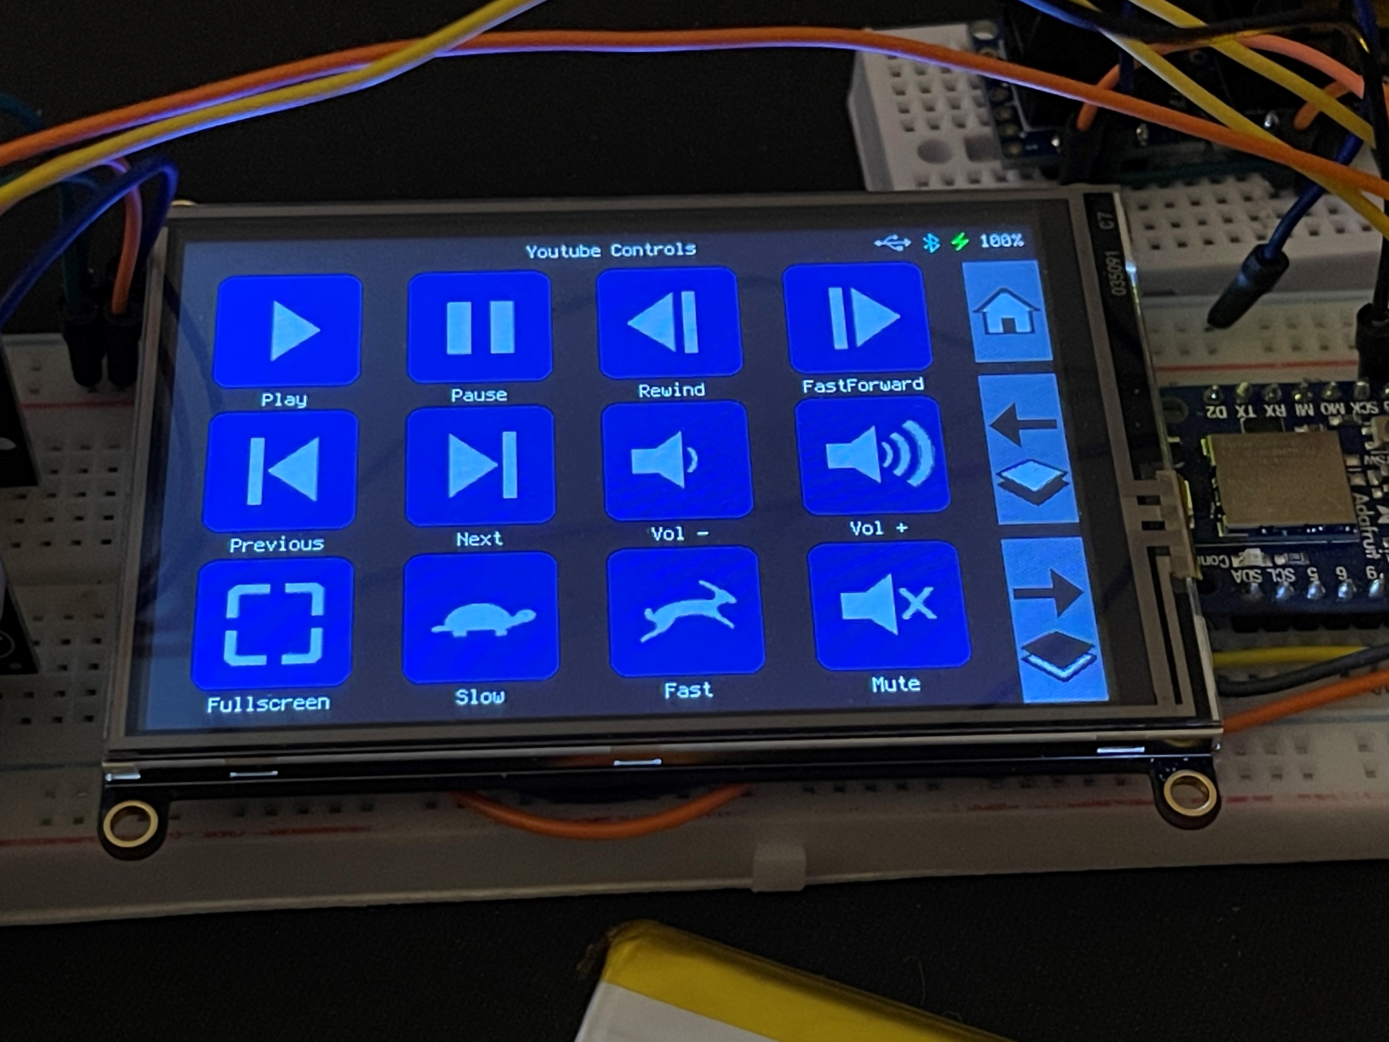
Slate On-Board Software Prototype
Prototype On-Board Software
Status-bar indicators for battery %, charging status, USB and Bluetooth host connection
Loads layer from config file
Right side buttons change layer or return to default (home)
Default layer, USB connected
Loading screen
Connect screen (no host)
YouTube Controls layer, Bluetooth connected
YouTube Controls layer,
USB & Bluetooth connected
Notes:
Our on-board Slate software is constrained to the 256KB memory size of the MCU, but so far, we’ve managed to implement many features without running over our limit. At the top of the screen, we have a status bar that shows the name of the current layer, along with indicators for USB or Bluetooth host connection status, battery percentage and charging status. We currently support a layout of 4x3 on-screen keys whose icons, labels, and underlying macros can be changed in the config file. We also have buttons to cycle through layers and return to the default layer if needed. One of goals is to find a cap on the number of layers, which will be determined by the amount of memory space the config file takes up when imported.
***new audio suggestion***
Our on-board Slate software is constrained to the 256KB memory size of the MCU, but we were able to implement many features without running over our limit. At the top of the screen, we have a status bar that shows the name of the current layer, along with indicators for USB or Bluetooth host connection status, battery percentage and charging status. We support a layout of 4x3 on-screen keys whose icons, labels, and underlying macros can be changed in the config file. We also have buttons to cycle through layers and return to the default layer if needed.

Slide 45
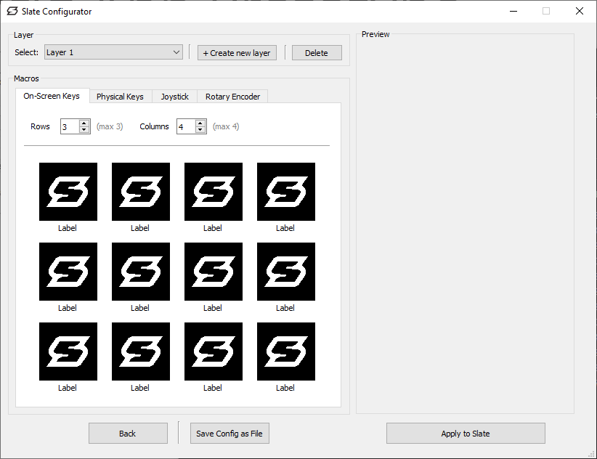
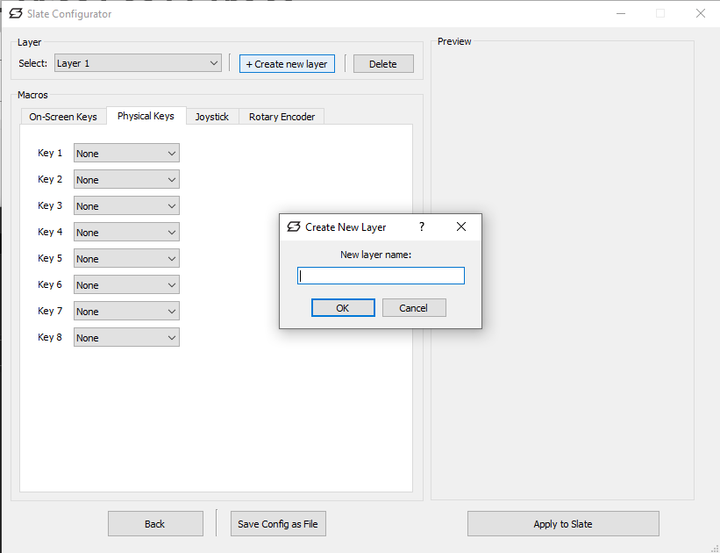
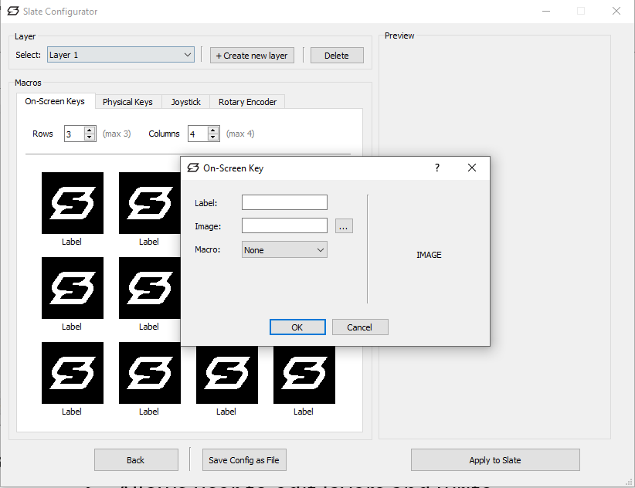
Configurator App Prototype
Prototype Configurator Application
UI designed in Qt Designer
Written in Python
Made for Windows
Allows user to edit layers and write config to Slate
Notes:
Using Qt Designer, we’re designing a GUI with an assortment of combo boxes, text inputs and dialogs give the user freedom to change macro functionality for each of the inputs offered by Slate. Once we’ve nailed down the final design, the GUI can be converted to Python where we’ll attach event listeners and functions to each element to make the application work as intended. The user can then apply the config to Slate which will check if it is connected and overwrite its existing config. Writing the config file over USB is required, and currently we’re looking into whether overwriting the config can be done without causing a soft reboot on Slate.
***new audio suggestion***
Using Qt Designer, we designed a GUI with an assortment of combo boxes, text inputs and dialogs give the user freedom to change macro functionality for each of the inputs offered by Slate. The GUI was converted to Python, where we attached event listeners and functions to each element to make the application work as intended. The user can then apply the config to Slate which will check if it is connected and overwrite its existing config. Writing the config file over USB is required, and once written, requires a soft reboot of Slate for the changes to be applied.

Slide 46
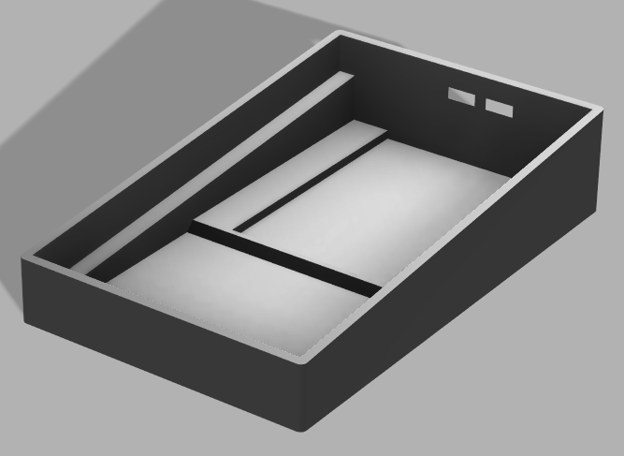
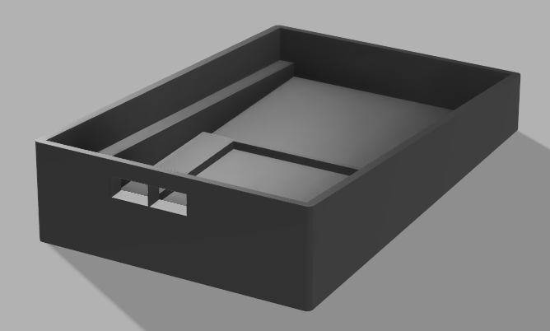
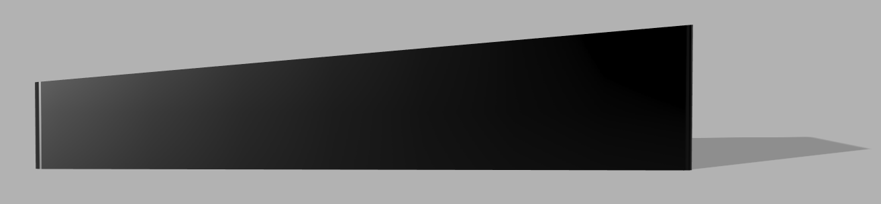
Enclosure Design
Fusion Model
3D-printable
Sized to PCB and USB/Power switch
Extrusion for battery placement
Faceplate design and fine-tuning of dimensions after we have PCB in-hand
Notes:
We’ve also started development on an enclosure design. The design allows the PCB to be mounted at an angle for better ergonomics. Cutouts are made for USB connection and a power slide switch on the back. There is also space on the inside-bottom of the enclosure to position a battery that is sized to our prototype battery dimensions. We’ll use 3D printing so we can get an accurately designed enclosure for low cost and with fast production time.
***New script suggestion***
We’ve also developed an enclosure design. The design allows the PCB to be mounted at an angle for better ergonomics. Cutouts are made for USB connection and a power slide switch on the back. There is also space on the inside-bottom of the enclosure to position a battery that is sized to our prototype battery dimensions. We utilized 3D printing for an accurately designed enclosure with low cost and fast production time.

Slide 47
Testing
Notes:
We’ll now talk briefly about testing, which includes what engineering requirements we intend to test and provide results to show we’ve met our expectations.

Slide 48
Testing Engineering Requirements
Performance
Perceived latency
Input accuracy
Functionality
USB
Bluetooth
Environment
Operating temperature
Energy
Battery charge time
Battery life
Record and analyze slow-motion frame-time
Does Slate register as USB/BLE HID device on a variety of hosts
Probe component and ambient temps during operation
Use timer for charging and depletion rates, compare to expected
Notes:
As we get our board assembled and working, we will be testing the following requirements. For performance we’ll test perceived latency from input to macro execution, as well as the accuracy of each input at detecting user interaction. For functionality we’ll test USB and Bluetooth host compatibility across a range of macros and check for any code exceptions. For environmental testing we’ll probe or poll for operating temperature to ensure we remain in-spec for component ratings and ambient temp within enclosure. Lastly for energy testing we’ll test battery charge time and battery depletion time.
As we got our board assembled and working, we tested the following requirements. For performance we tested perceived latency from input to macro execution, as well as the accuracy of each input at detecting user interaction. For functionality we tested USB and Bluetooth host compatibility across a range of macros and check for any code exceptions. For environmental testing we probed or polled for operating temperature to ensure we remain in-spec for component ratings and ambient temp within enclosure. Lastly for energy testing we tested battery charge time and battery depletion time.

Slide 49
Project Test Plan and Implementation
Engineering Requirement | Test Implementation
Slate’s touch screen input shall have an input response time less than 100ms. | Record touchscreen press and computer screen in slow-motion (240fps) in same shot. Analyze frames to determine the response time of the touch screen.
Slate’s physical keys shall have an input response time less than 100ms. | Record physical key press and computer screen in slow-motion (240fps) in same shot. Analyze frames to determine the response time of the physical key.
Slate’s touch screen will have input accuracy greater than 90%. | Load testing script asking user to press specific on-screen buttons. Compare requested versus actual received input and compute accuracy percentage.
Slate shall operate wirelessly for at least 10 hours at idle (ready) state starting with a fully charged battery. | Fully charge Slate battery and connect Slate to a Bluetooth host device. Leave host device plugged in (to remain operating) and Slate unplugged. Record depletion time to 0%.
Slate shall provide at least six programmable macro functions. | Open configuration software and verify six unique macro functions are available. Verify all six are operational when applied to Slate.
Slate shall maintain all performance and functionality requirements when connected via Bluetooth. | Verify all applied macro functionality is maintained when using Bluetooth. Note: not all macros are intended to be compatible with a mobile device, instead being fully compatible via Bluetooth to a Windows PC.
Slate shall maintain performance and functionality requirements no matter the power source. | Verify all applied macro functionality is maintained when using battery or USB power.
Slate’s battery shall charge from 0% to 50% in less than 4 hours when connected to a USB power source. | Deplete Slate battery until non-operational. Then plug into power-source and periodically check battery percentage by turning Slate on to see the amount, and then off.
Slate shall provide at least three layers for selection by the user. | Open configuration software and verify at least three layers can be created, edited, and applied to Slate. Check that these layers are selectable when Slate is operating.
Notes:
Our test plan follows our engineering requirements. Shown below are the implementations for each testable requirement:
For project testing, we gathered our engineering requirements and developed a test implementation for each. Our requirements and their associated test are shown below. Next, we’ll show a brief example of the highlighted test in action.

Slide 50
Administrative Content
Notes:
We will now finish our presentation with some administrative content

Slide 51
Budget
Cost Area | Quantity | Price (USD)
Development Kits | 3 | $247.17
PCB Manufacturing | 5*2 | $90.50
PCB Components | 52 x 5 | $166.25
PCB Assembly | 5 | $0
Total Cost |  | $503.92
Notes:
In total, we ended up spending a little over 500 dollars on our project. The major components of the development kits were Breakout boards with our controller unit, screens and user input components. PCB manufacturing was done twice and included SMT stencils for aid with assembly. Our components were all ordered from mouser at the same time, and we ordered enough for 5 boards in case of errors during assembly. Since we did not outsource PCB assembly like we originally planned, we were able to stay well below our project constraint of $1000.00 that we set at the onset of the project.
Development Kits:
Feather: 3 x 24.95
Screen: 3 x 39.95
Battery: 1 x 14.09
Rotary Encoder + Tuning Knob : 1 x (9.29+8.99)
Keyboard: 1 x 11.99
Joystick: 1 x 7.99
PCB Manufacturing: Based on what we paid from JLCPCB:
PCB Assembly: Estimated based on AAPCB's website

Slide 52
Questions?
Please reference slide number

